Slide 1

MINOR PROJECT-I ON PLATTERLY - A COMPLETE SOLUTION FOR TIFFIN SERVICE (MCA - I SEMESTER; BATCH 2022-24)
Presentation by:
Manan Arora (36211604422)
Sachit Gambhir (02911604422)
Prachi Gupta (08011604422)
Internal Guide
Dr. Ritika Wason, Dr. Parul Arora,
Dr. Vaishali Joshi (Asst./Assoc. Prof., BVICAM, New Delhi)
17th February 2023
Notes:
1

Slide 2
Contents
Problem Description
Overview of Project
Aim and Objectives
Functional requirements
Technology Used for Project Development
Roles of Team Member
Project Modules
Screenshots
Future Modifications

Slide 3
PROBLEM DESCRIPTION
The problem that the tiffin service website aims to address is the inconvenience and hassle of preparing meals for busy individuals who do not have the time or skills to cook nutritious meals.
The website provides an online platform for users to order and receive home-cooked meals conveniently and at an affordable cost.
The website's primary goal is to make healthy and tasty food available to everyone, regardless of their lifestyle or dietary preferences.
Additionally, the website provides an opportunity for talented home cooks to share their culinary skills with the community, earn a decent income and promote healthy eating habits.
The website also helps to reduce food wastage by producing only the required quantity of meals as ordered by customers. The website is a one-stop solution for users looking for healthy and delicious meal options while saving time and effort in their busy lives.

Slide 4
Overview of Project
Platterly Tiffin Service is a team of food enthusiasts, led by Manan Arora, Sachit Gambhir, and Prachi Gupta. We understand the importance of healthy and delicious food in a busy lifestyle, which is why we started this tiffin service.
Our aim is to provide convenient and affordable home-cooked meals to people who do not have the time or skills to cook. We believe that everyone deserves to eat healthy and tasty food, which is why we work with talented home cooks who are passionate about cooking.
We are committed to providing our customers with the best service possible. We offer a wide range of meal options, including vegetarian and non-vegetarian meals, customized to suit the customer's dietary requirements. We also provide a reliable and timely delivery service, ensuring that the meals reach.
It provides best quality services to users.

Slide 5
Aim and Objectives
Aim:
To develop a web-based application for providing the tiffin services to users.
Objectives:
To design a relational database for managing the users ,tiffin vendors and orders.
To design user-friendly interfaces.
To reduce hassle of buying groceries and looking for home cooks around them.

Slide 6
Functional requirements
A functional requirement defines a function of a system or its components. Functional requirements may be calculation, technical details, data manipulation and processing and other specific functionality. There are various functional modules:
• User Registration : New users can register
• User Login : Registered users can login
• Admin Login : Admins can login and manage the whole functionality
• Registered Users can change their credentials
• Shopping Cart : Registered Users can tiffin to cart
• Payment Form : Registered Users can make payment for the tiffin they purchase

Slide 7
Tools and Technology Used
H/W Requirement for Development Architecture
• X86 or X86-64 bit hardware architecture
• Intel/AMD processor with compatible Motherboards Processing Power
• Core2Duo 2.0-gigahertz (GHz) processor or faster Memory
• SSD : WD 240 GB SATA
• HDD : WD SATA 1TB
• Graphics Card: NVidia Gtx 1650 4gb VRAM
• Motherboard: MSI H310M Pro VDH
• Ram: Corsair 8gb Ram disk
• At least 10 gigabytes (GB) of available space on the hard

Slide 8
Tools and Technology Used
S/W Requirements for Development
1) Operating System : Windows 7 or higher
2) Front end : HTML,CSS
3) Backend : PHP
4) Database : MySQL
5) Text Editor : Notepad++ or VS Code

Slide 9
Roles
Role of Each Member :-
Manan Arora
Report Writing
Customer Module
2. Prachi Gupta
Graphics
Tiffin Vendor Module
3. Sachit Gambhir
Admin Module
Presentation

Slide 10
Project Modules
Project Modules:
Customer Module
Tiffin Vendor Module
Admin Module

Slide 11
CUSTOMER MODULE
Provides Login Interface for registered customers.
Provides a Signup Interface for new customers.
Providing wide range of tiffin as per their taste.
Providing customers to update their account details.
Provide user-friendly interface to avail tiffin service as per their requirement.
Receiving feedback from customers, if facing any issue.

Slide 12
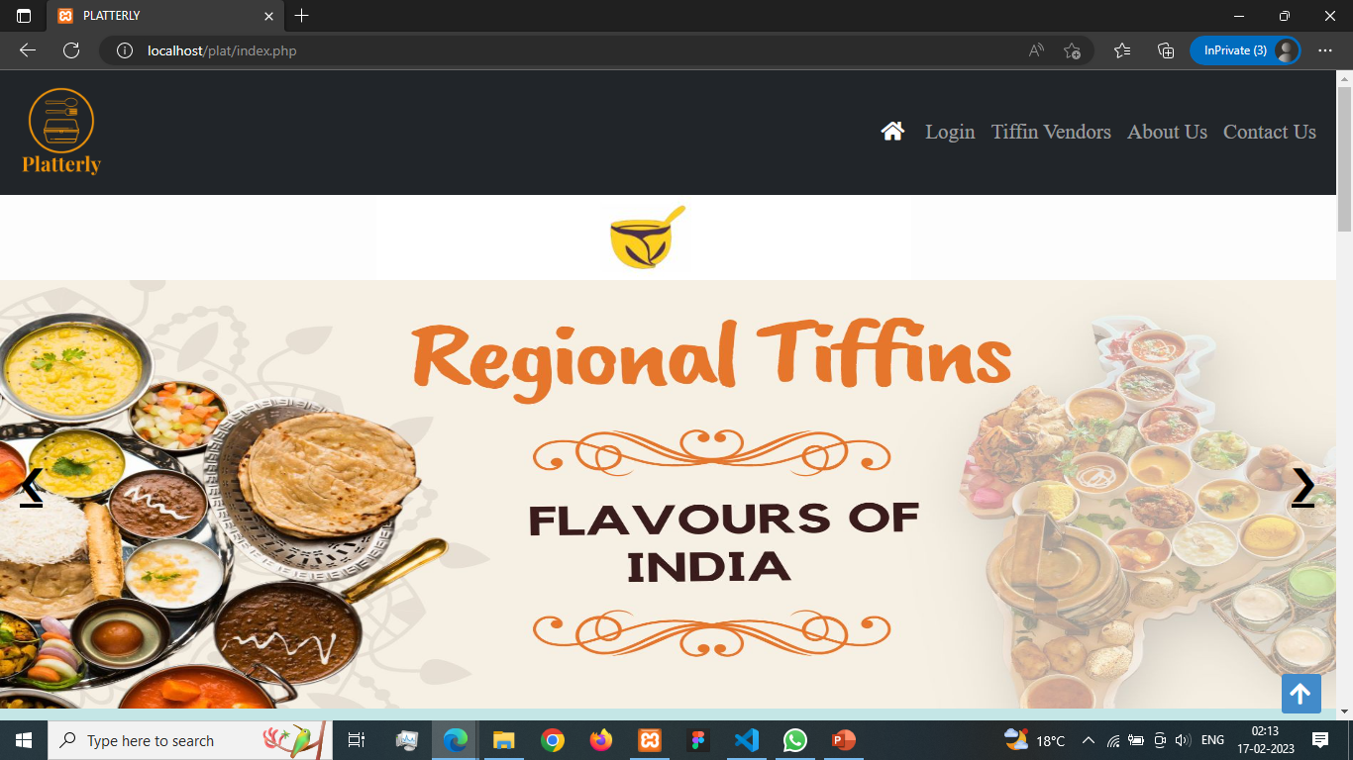
Screenshots

Slide 13
Screenshots

Slide 14
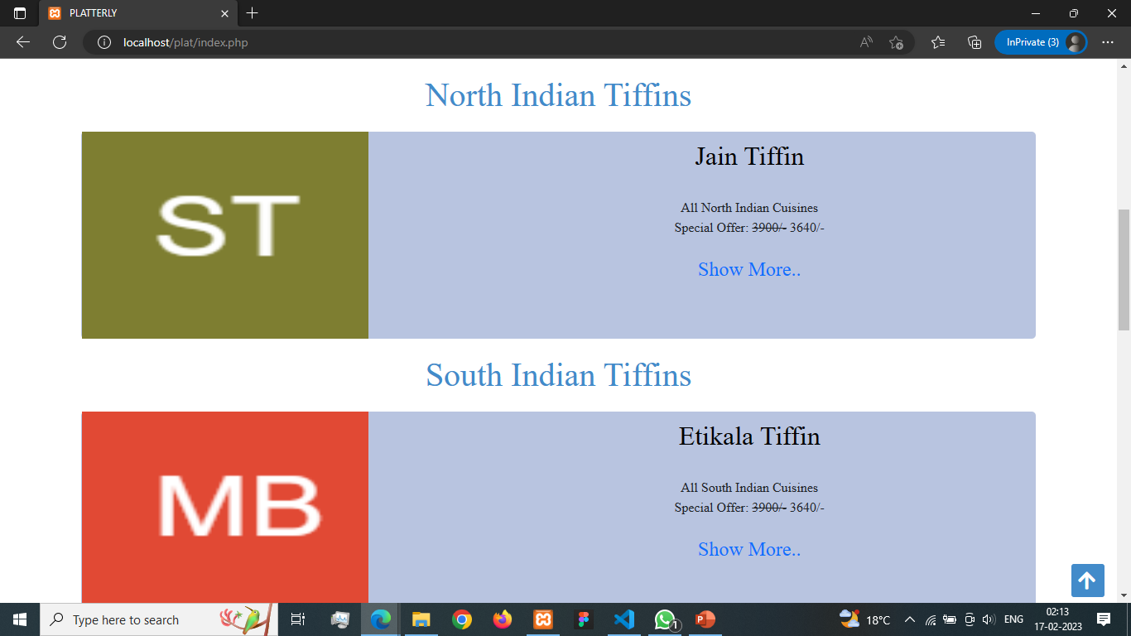

Slide 15
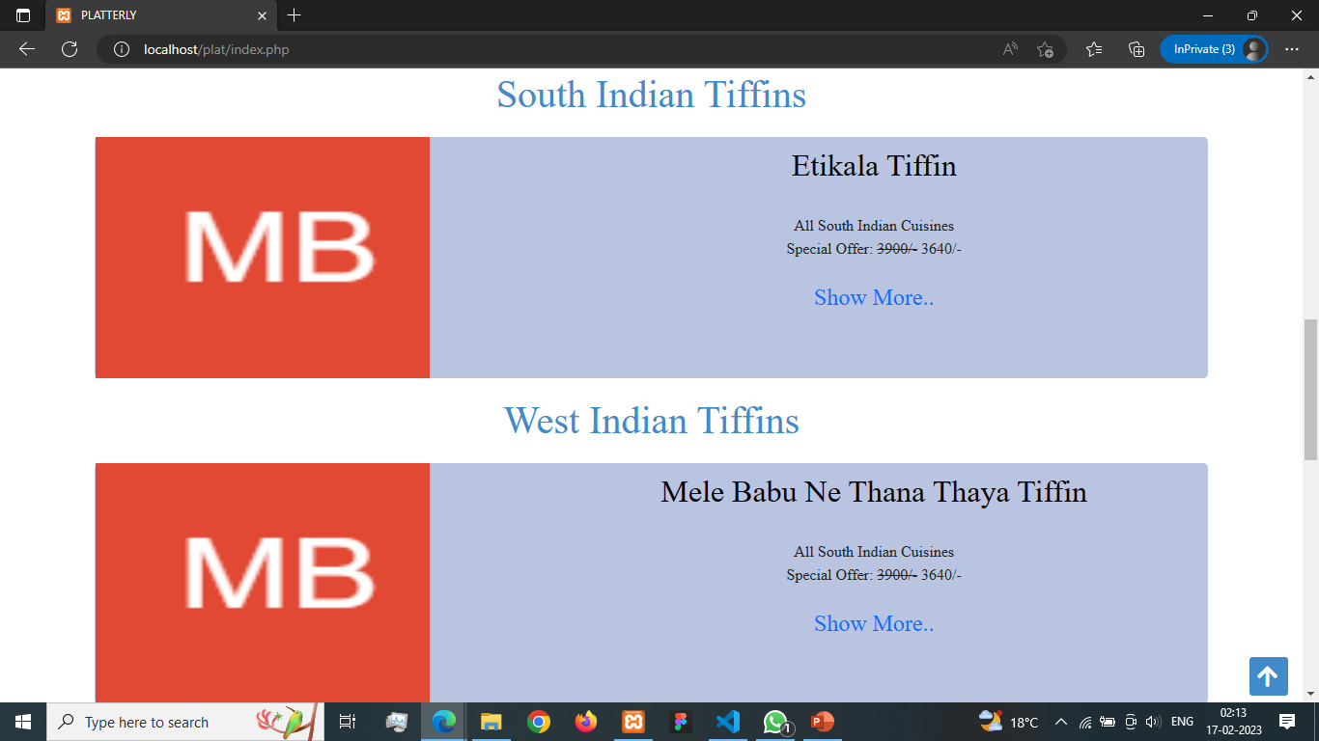

Slide 16
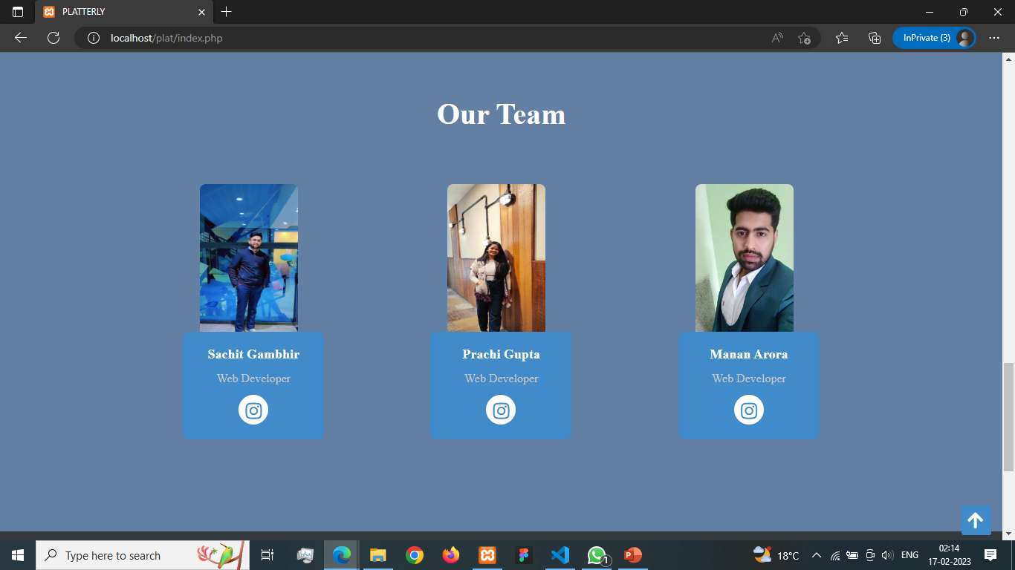

Slide 17
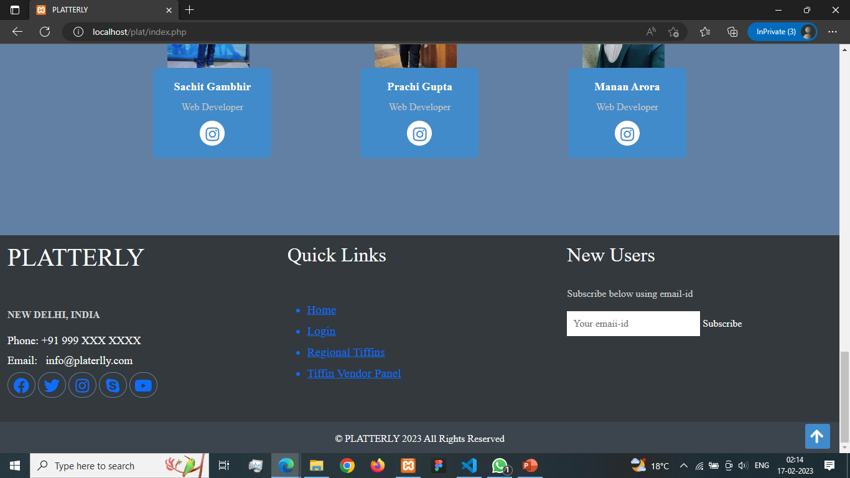

Slide 18
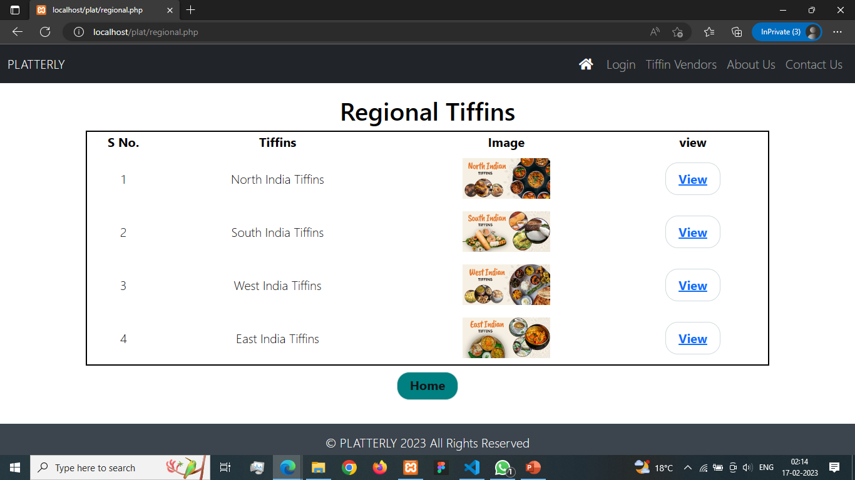

Slide 19
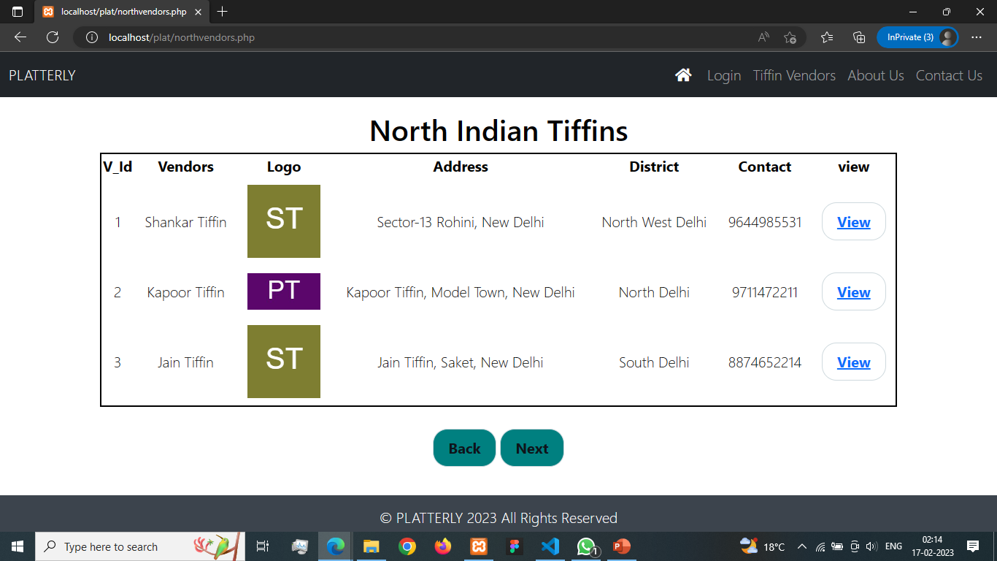

Slide 20
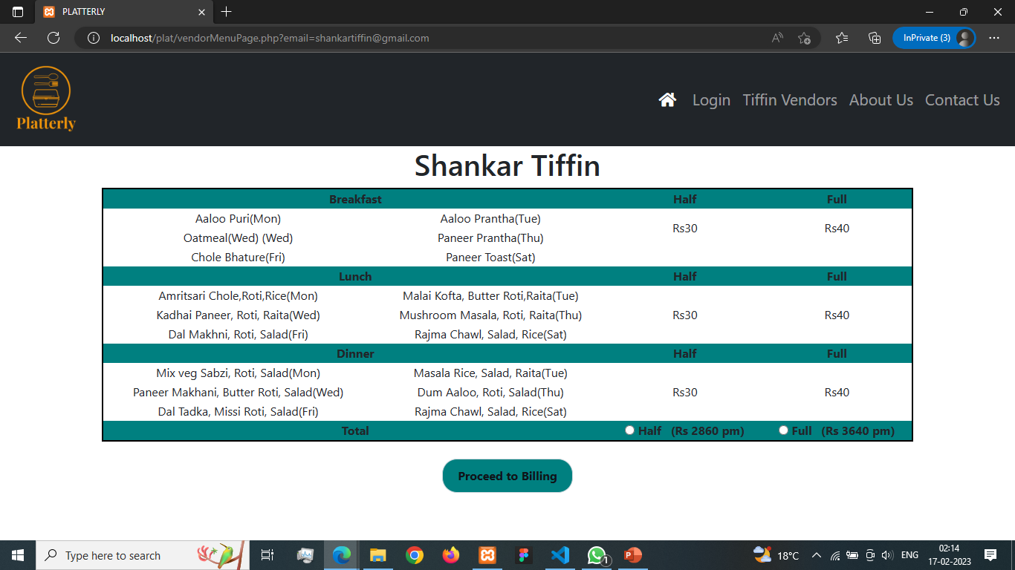

Slide 21


Slide 22


Slide 23
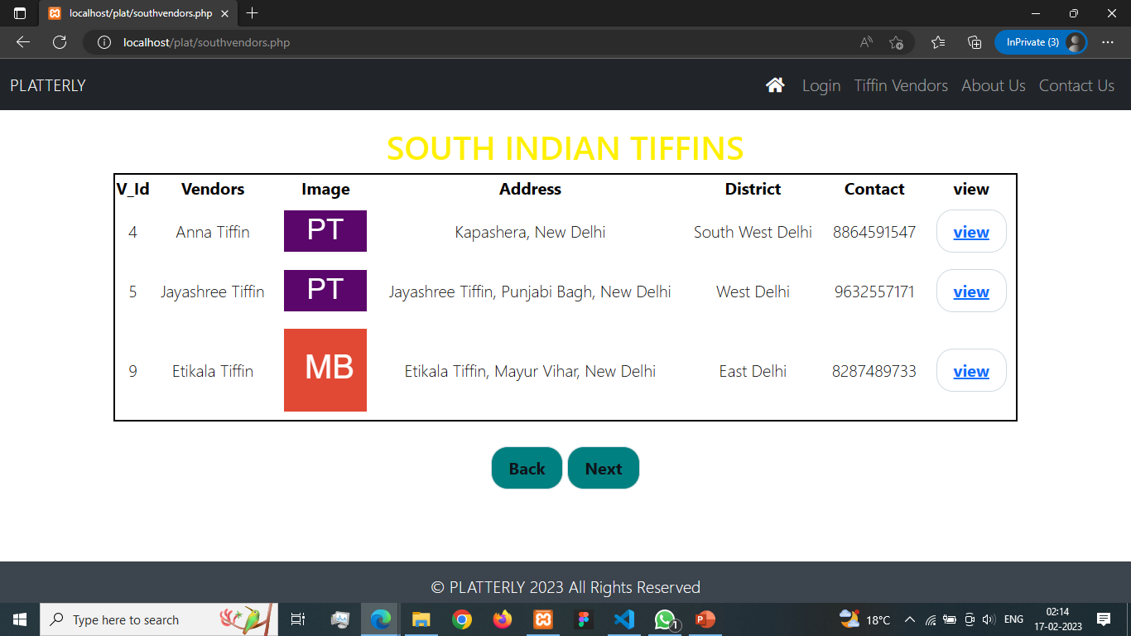

Slide 24


Slide 25
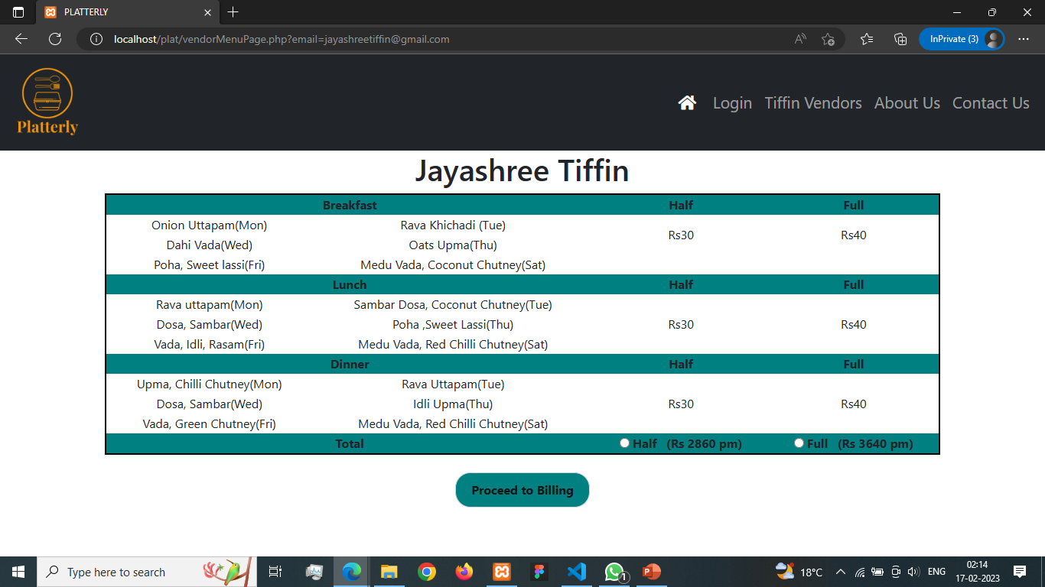

Slide 26


Slide 27
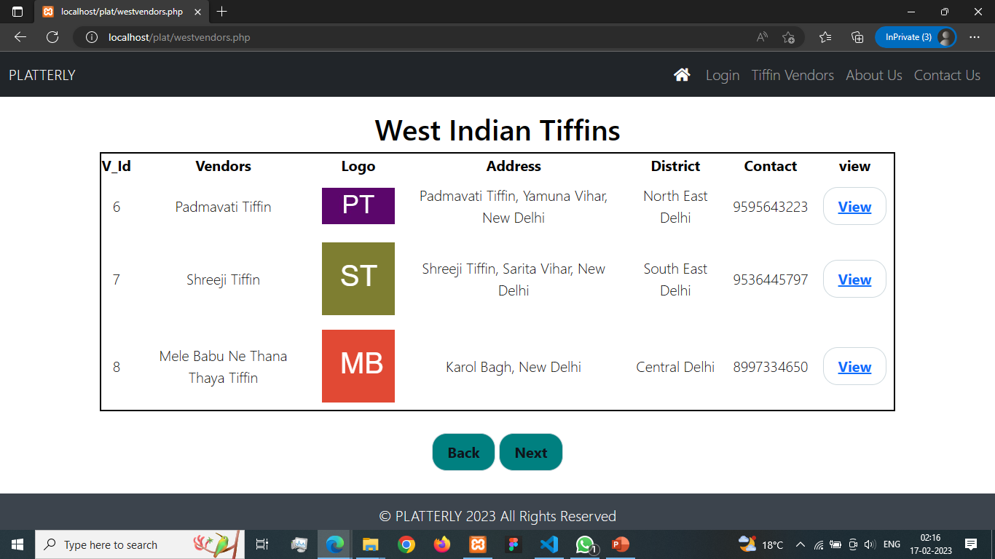

Slide 28


Slide 29


Slide 30


Slide 31
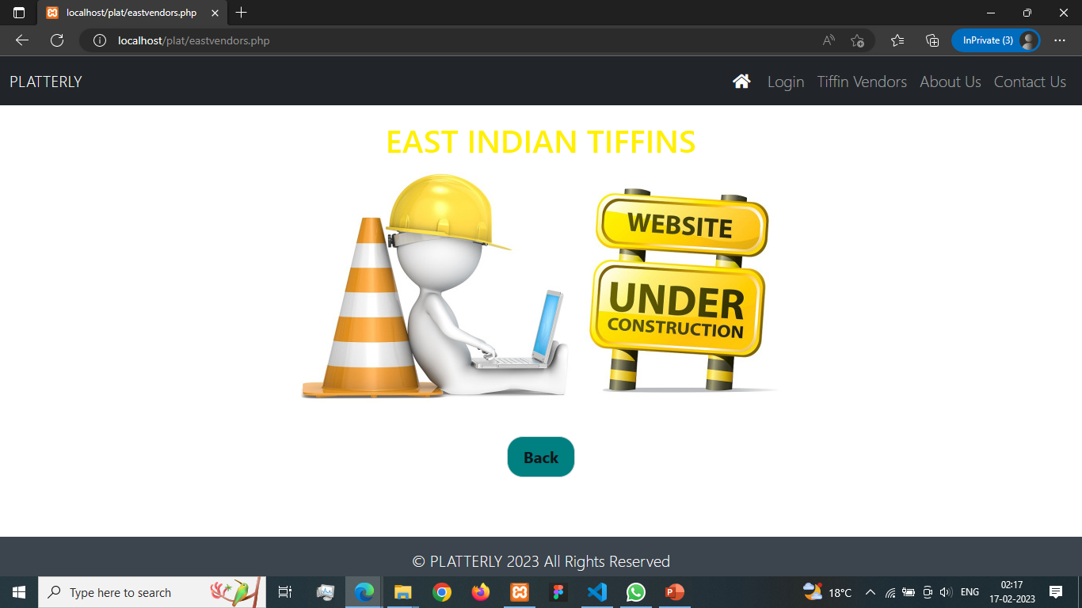

Slide 32
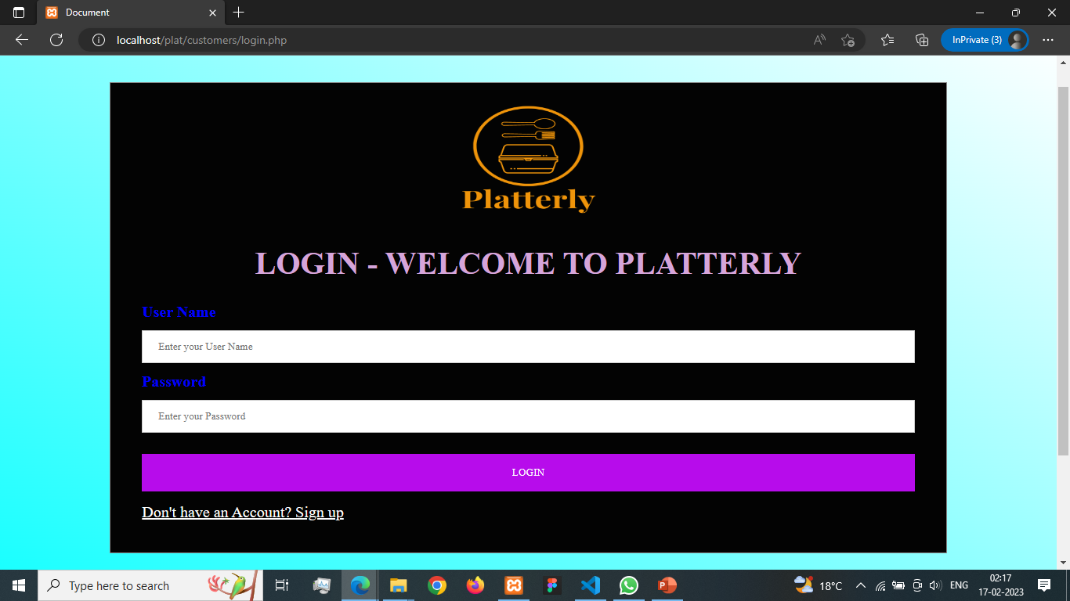

Slide 33
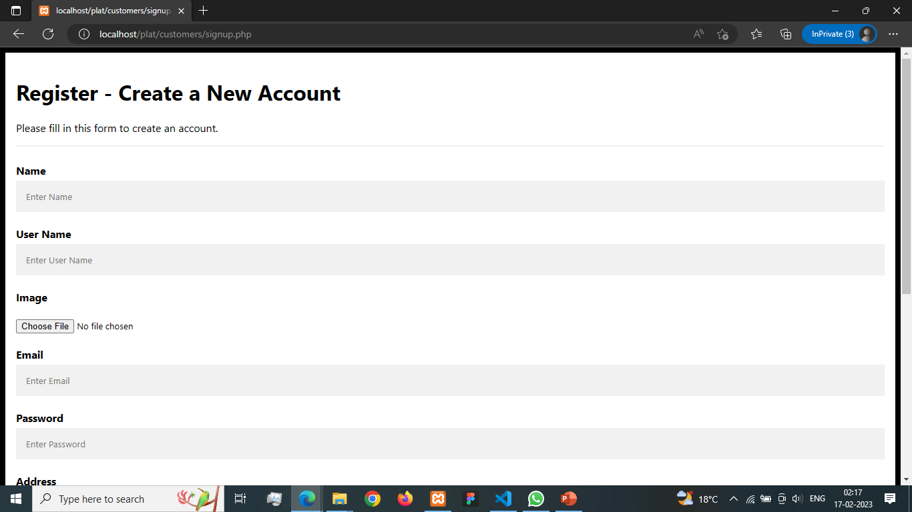

Slide 34
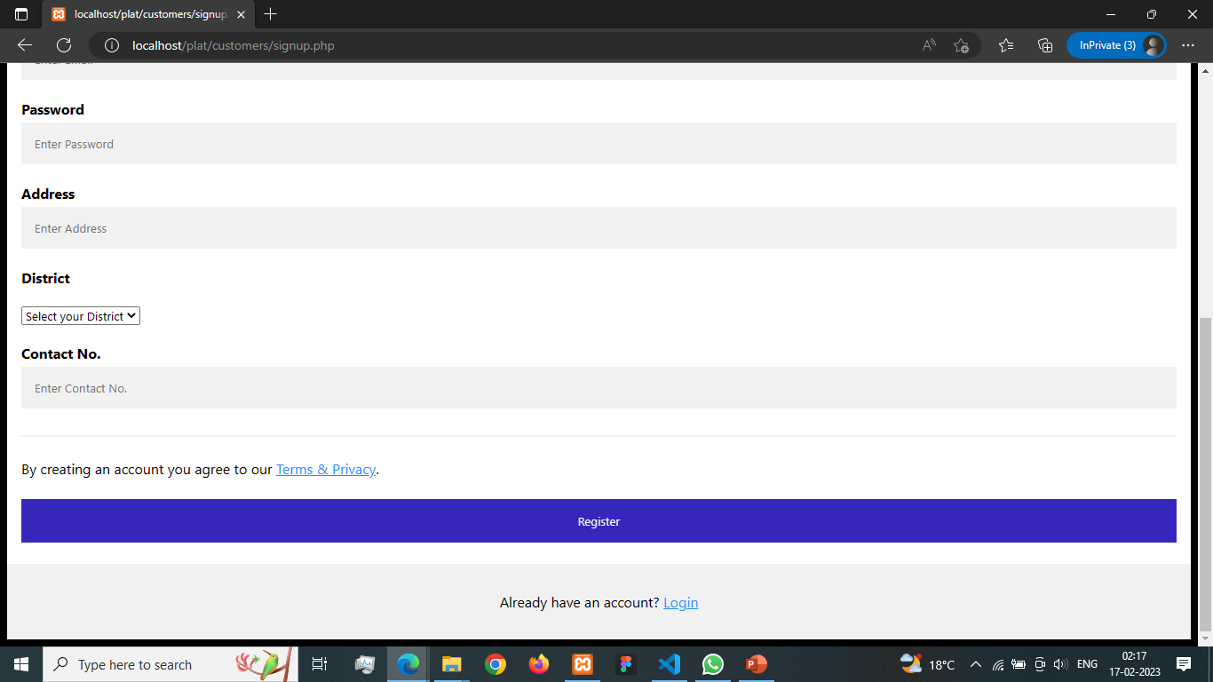

Slide 35
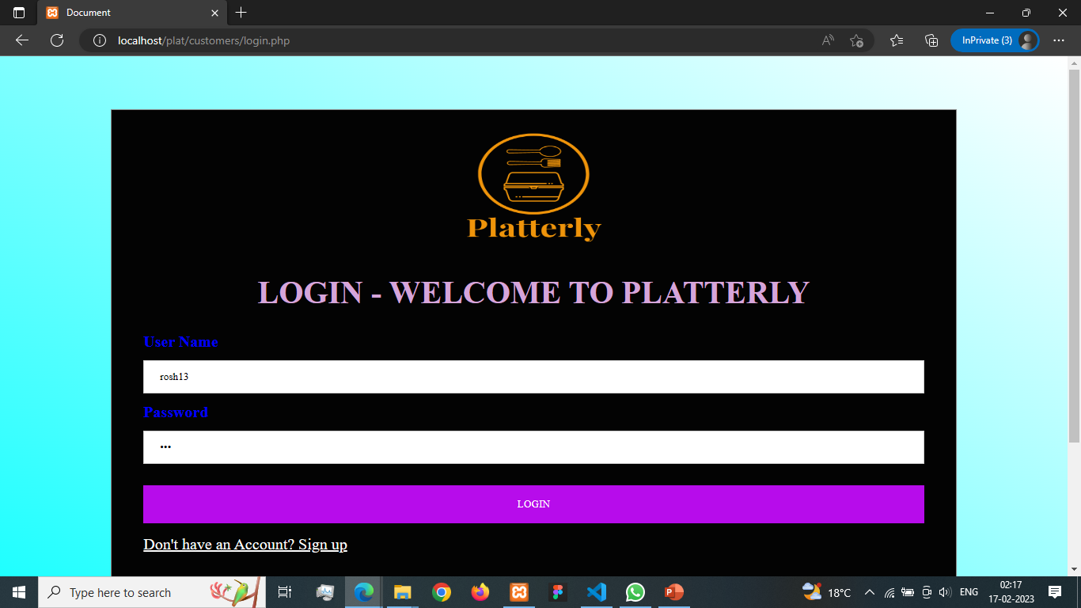

Slide 36
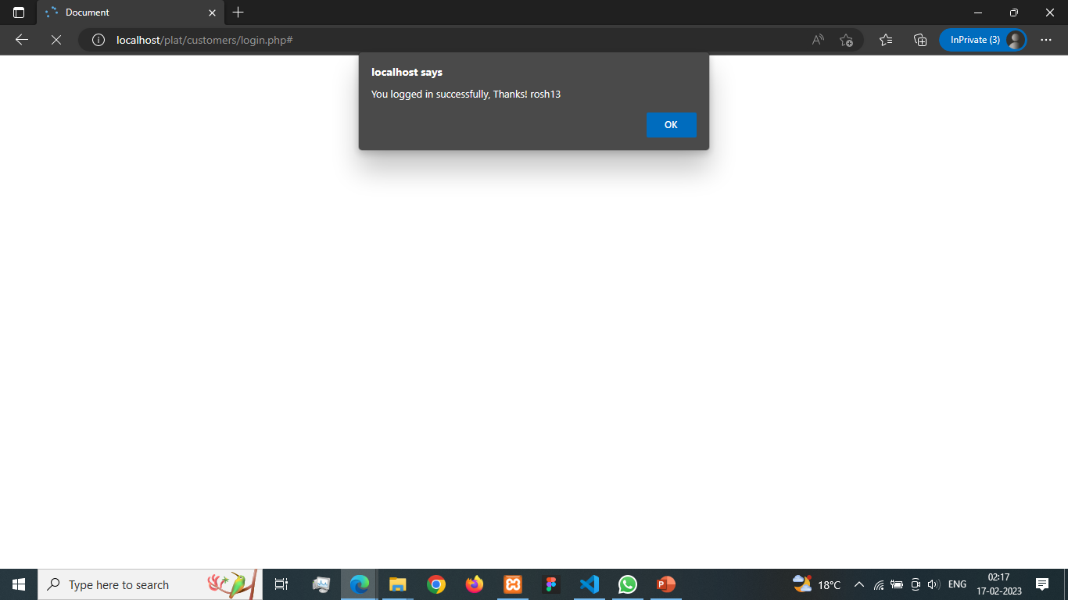

Slide 37
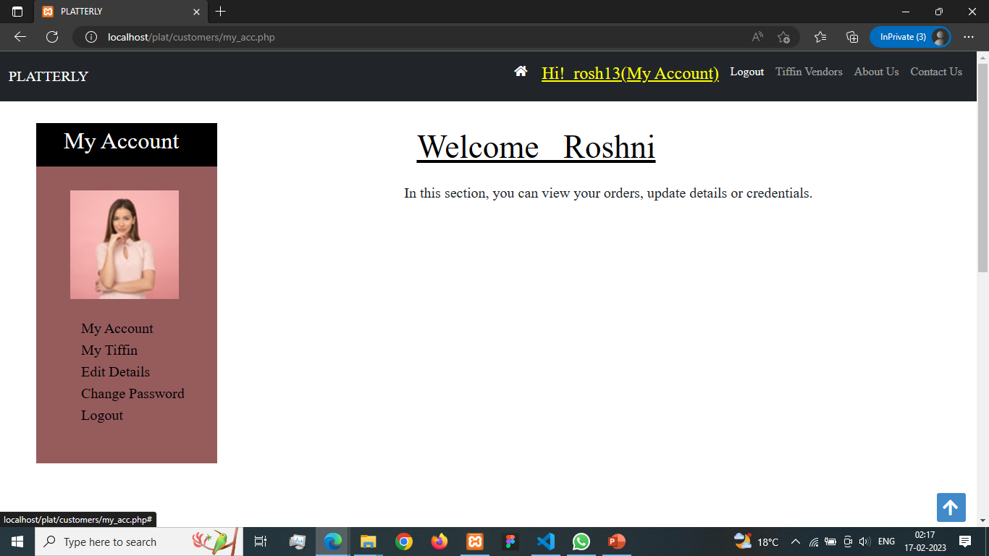

Slide 38
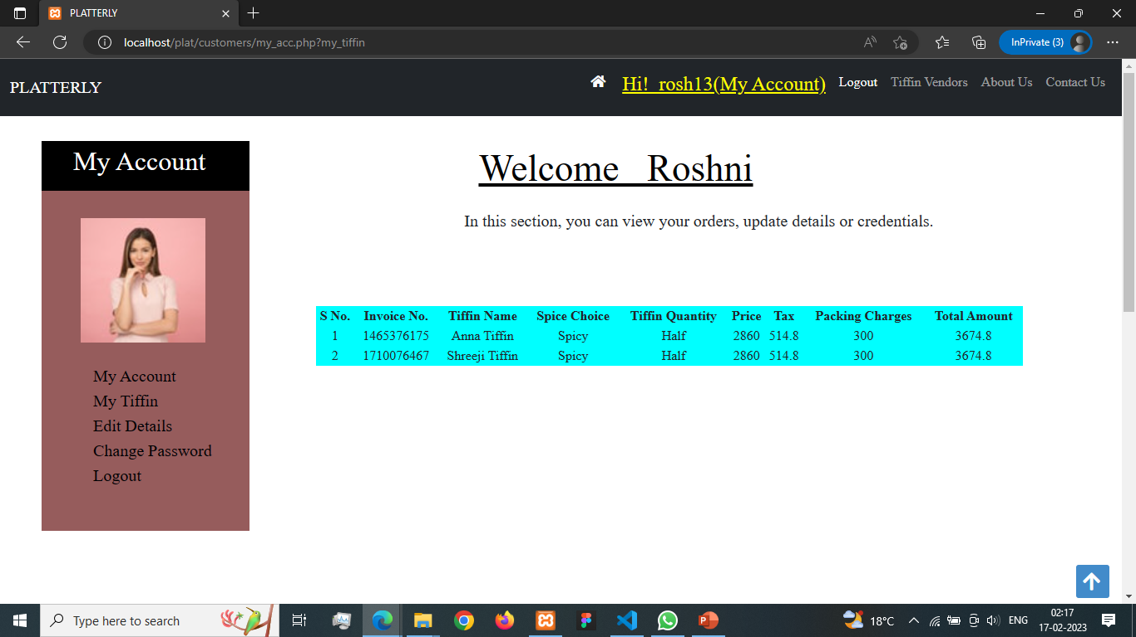

Slide 39
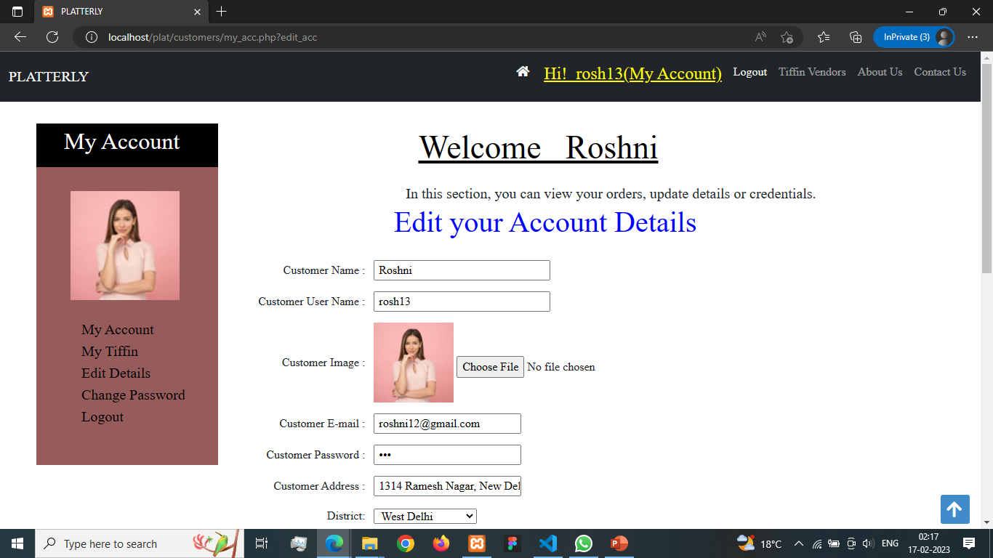

Slide 40
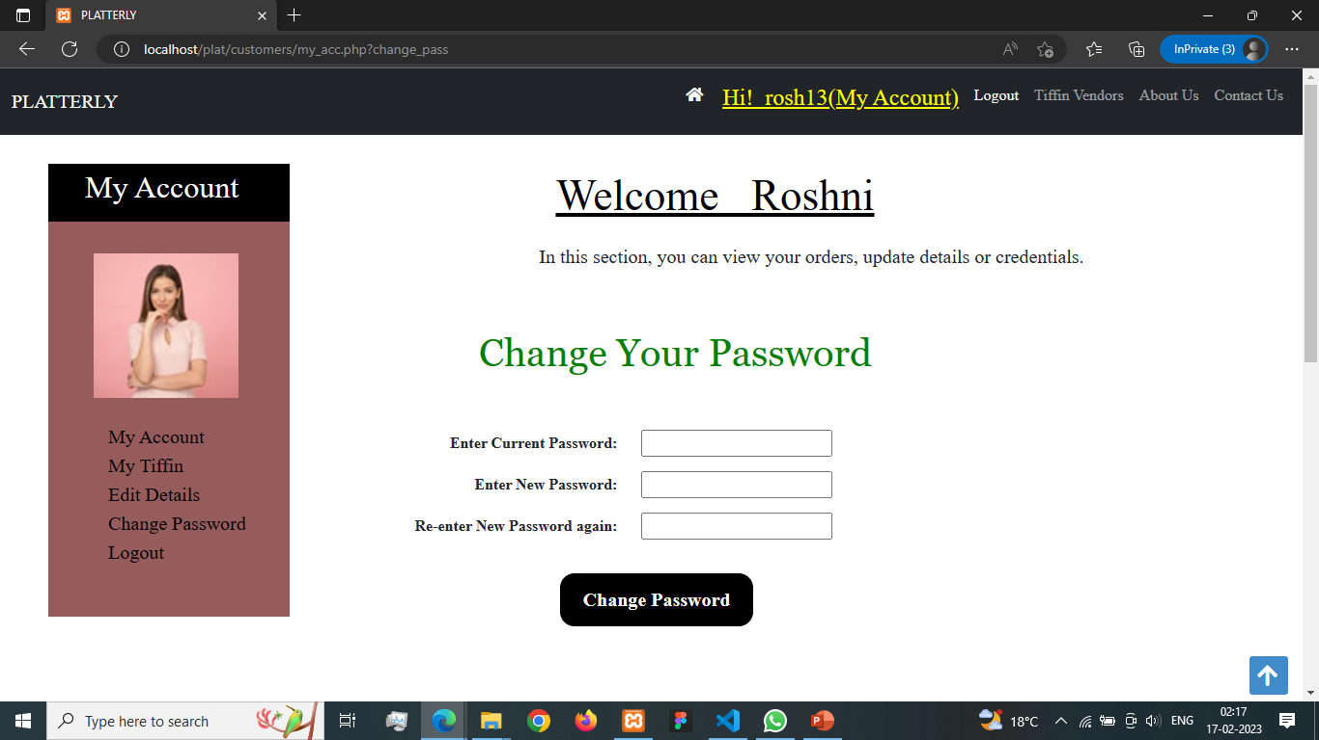

Slide 41
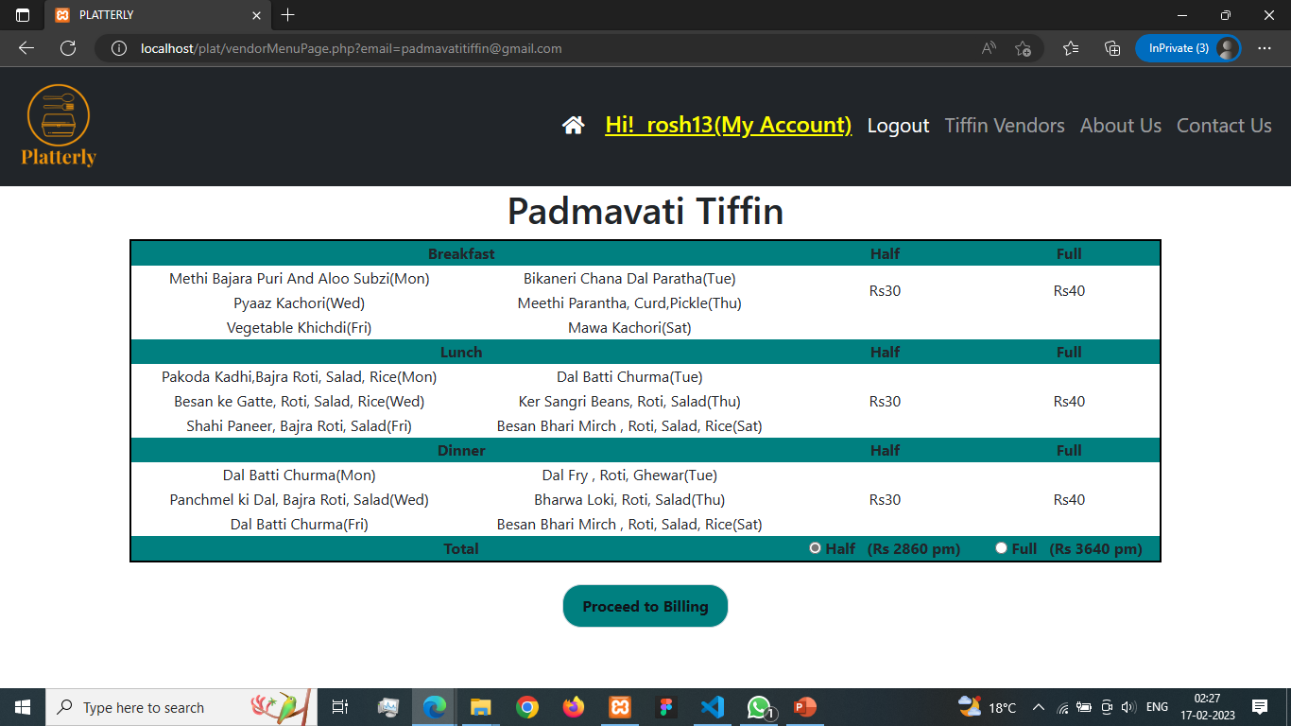

Slide 42
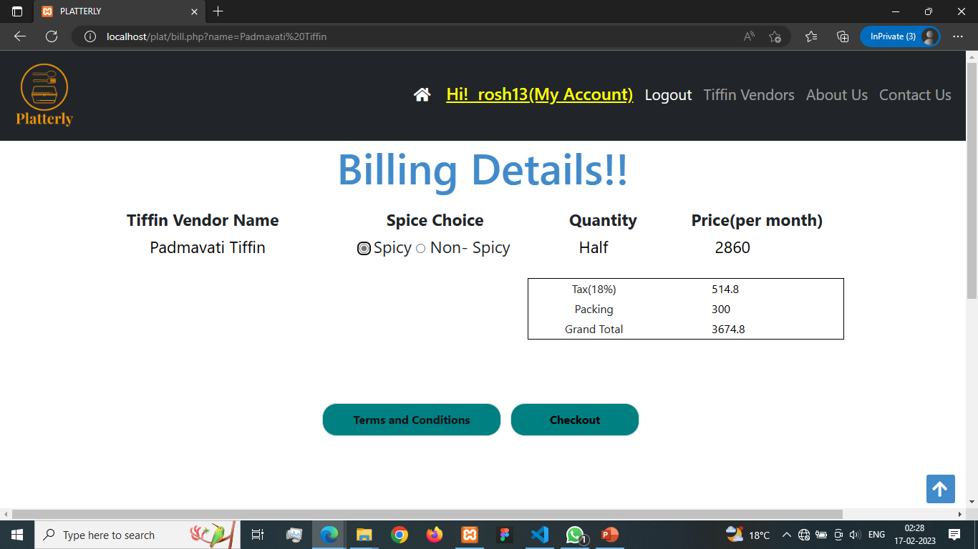

Slide 43


Slide 44
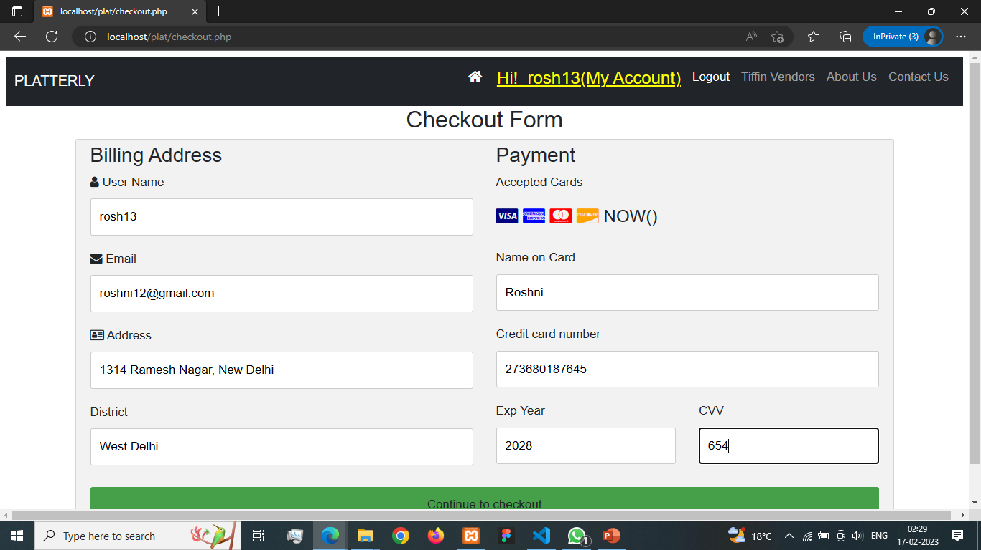

Slide 45


Slide 46
TIFFIN VENDOR MODULE
Providing Login Interface for registered tiffin vendors
Provides a Signup Interface for new tiffin vendors.
Providing interface to list their menu items and pricing after negotiation and approval by admin.
Receiving feedback vendors, if facing any issue.

Slide 47
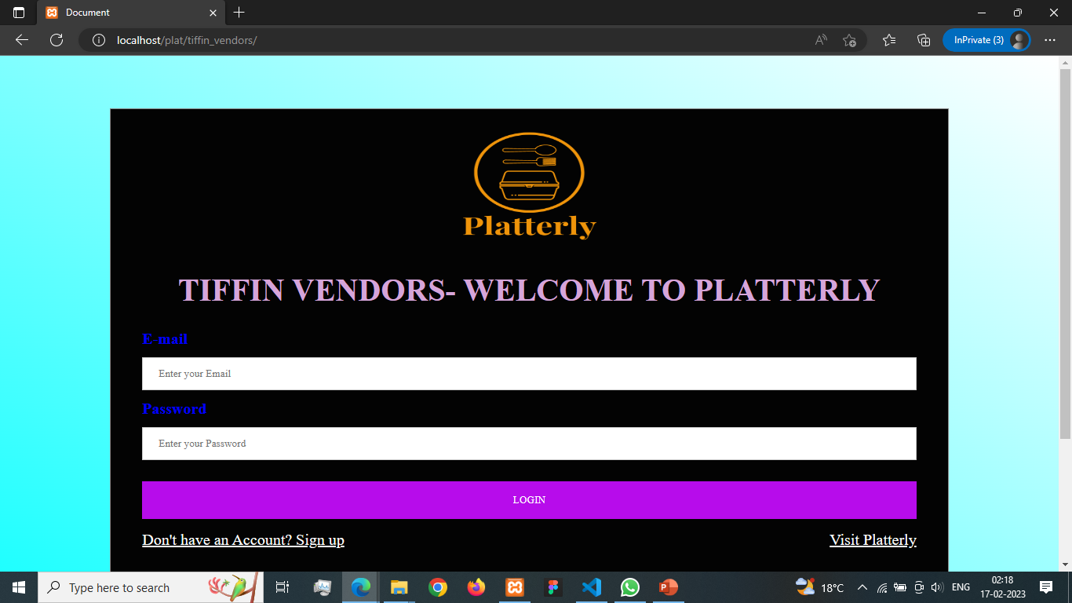

Slide 48
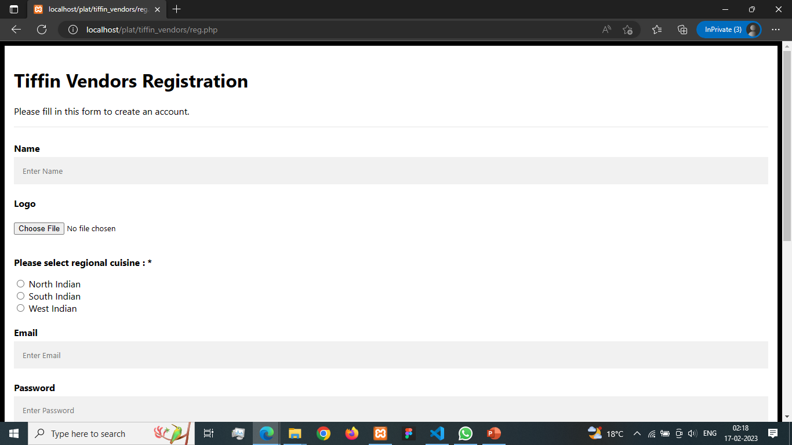

Slide 49
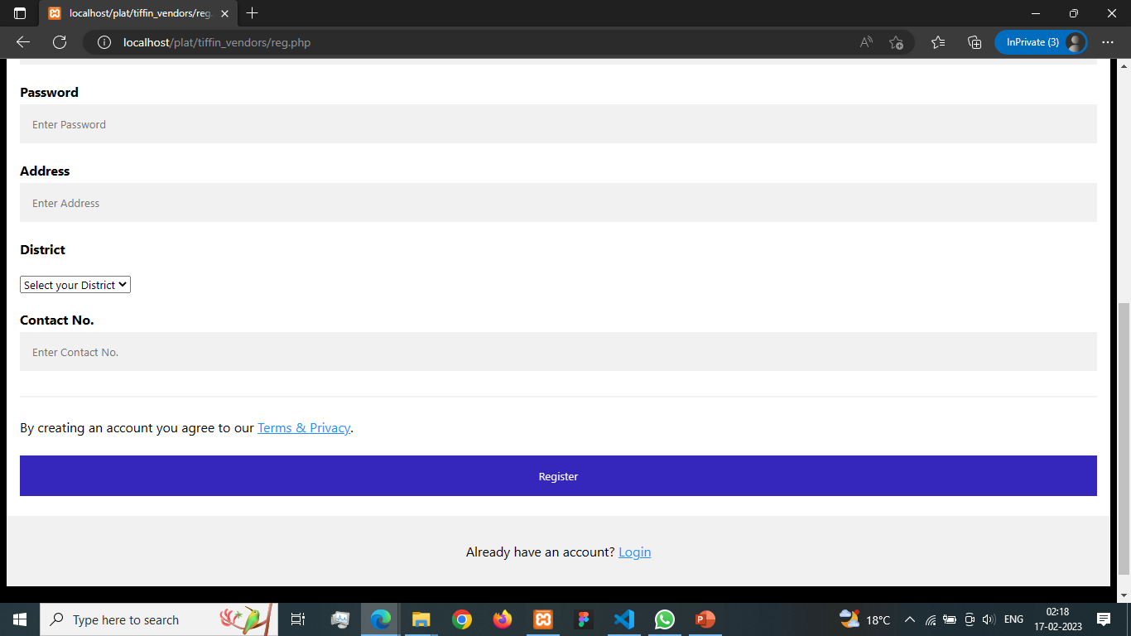

Slide 50


Slide 51


Slide 52
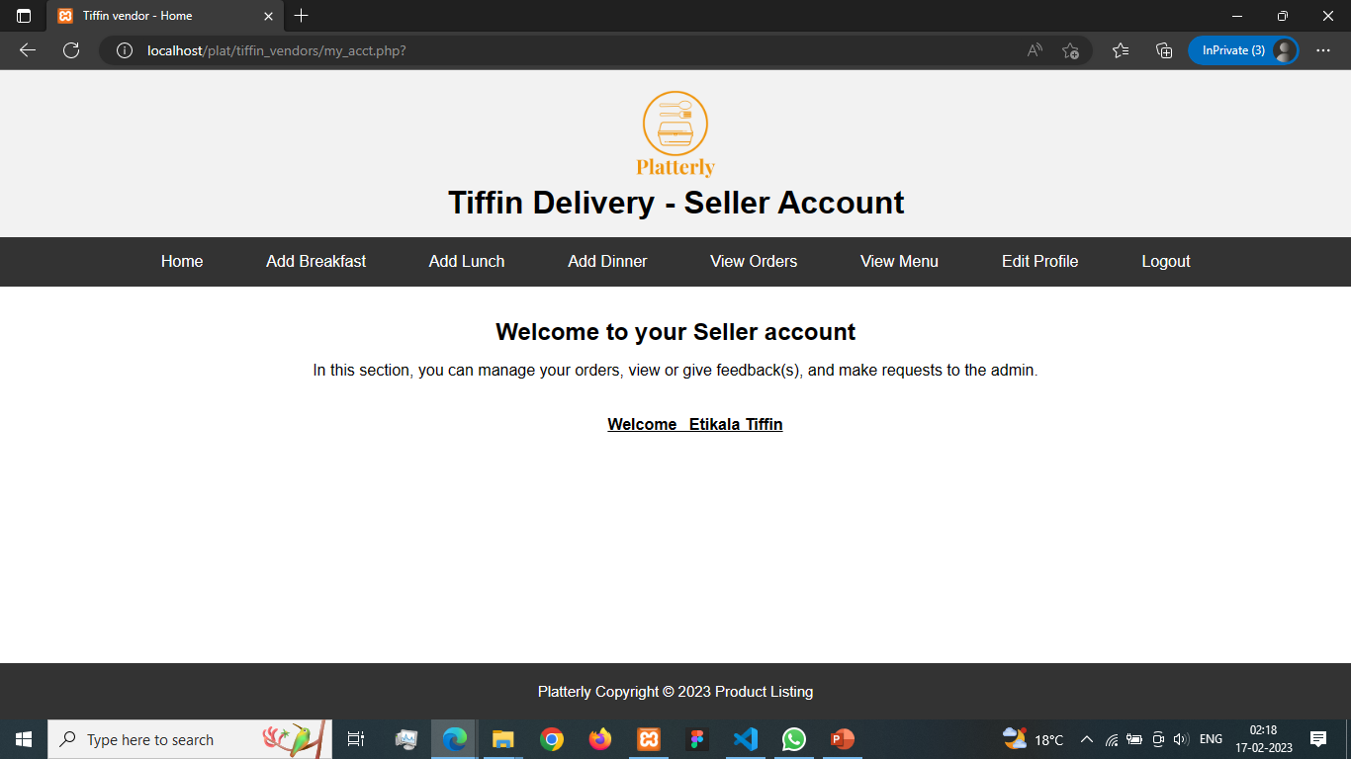

Slide 53
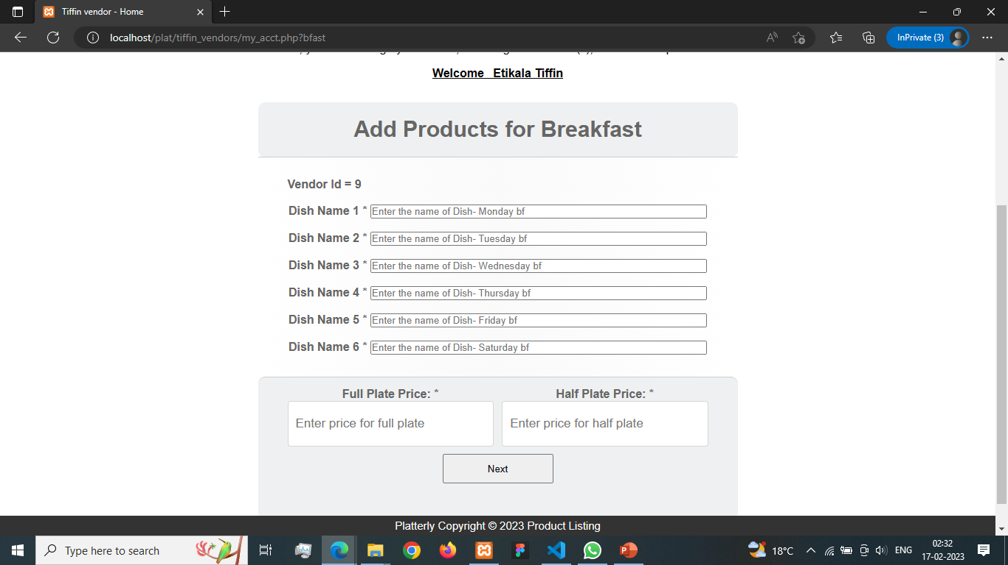

Slide 54
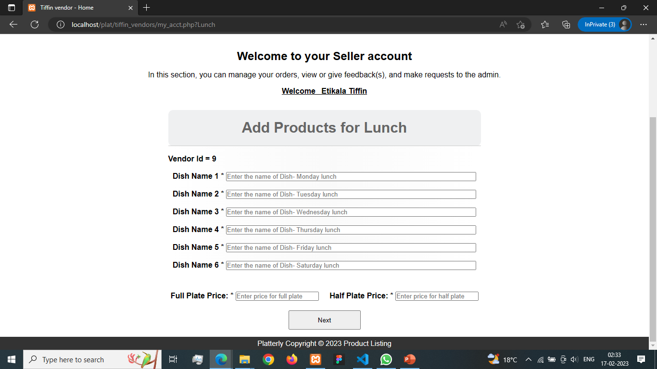

Slide 55


Slide 56
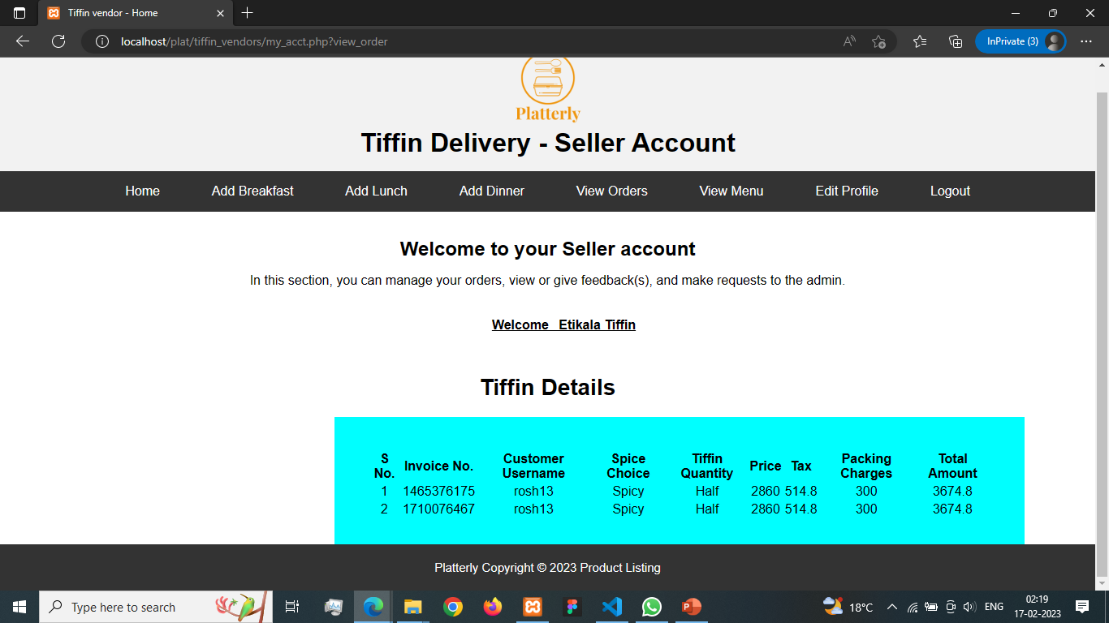

Slide 57
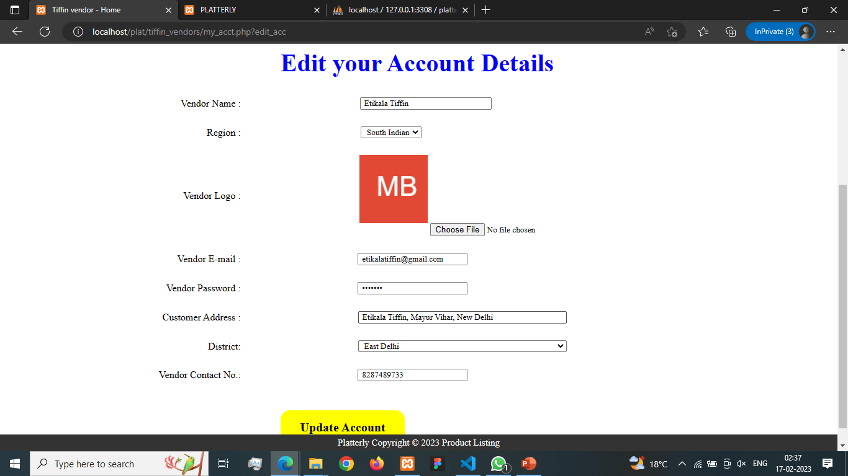

Slide 58
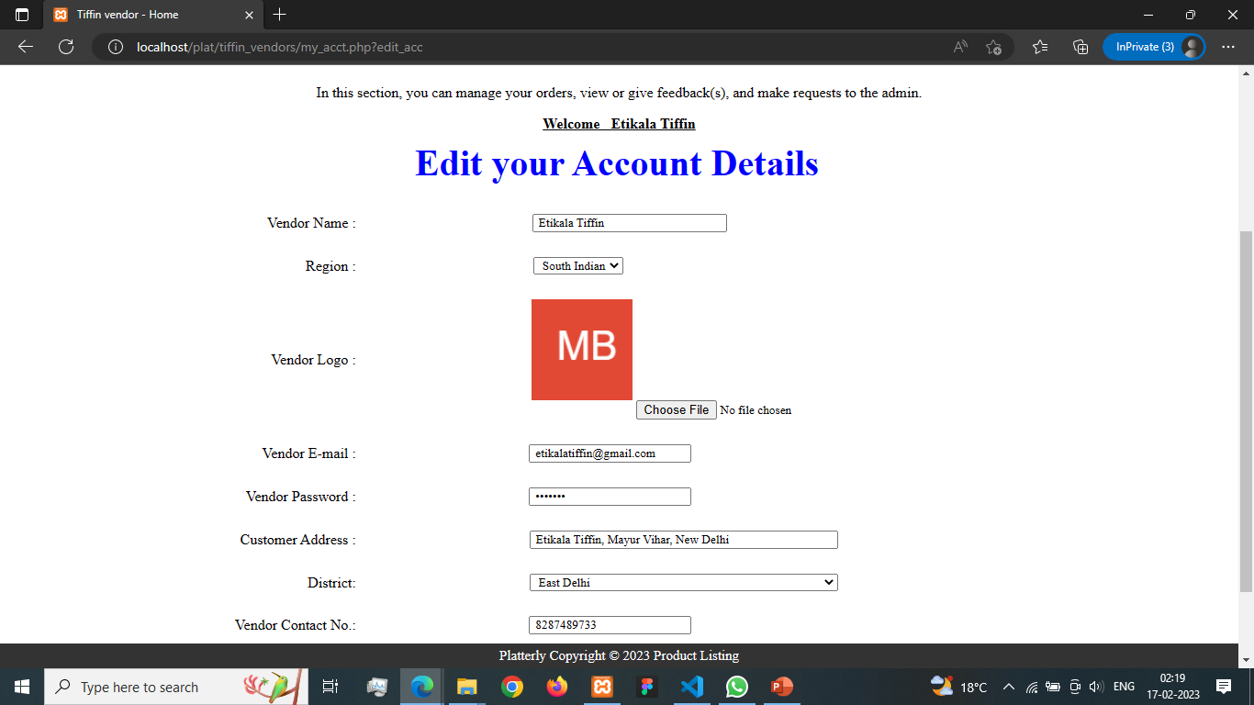

Slide 59
ADMIN MODULE
Managing customers, tiffin vendors details.
Managing tiffin orders.
Updating details of users and vendors.
Updating menu details for each vendor.
Removing dormant users and vendors.
Handling feedbacks.

Slide 60
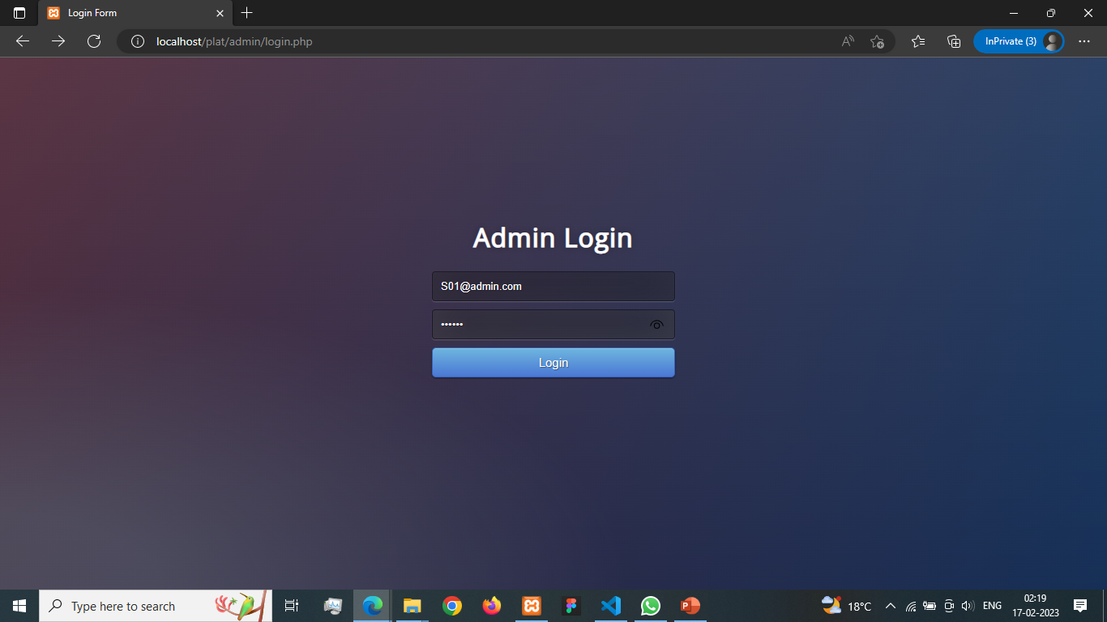

Slide 61
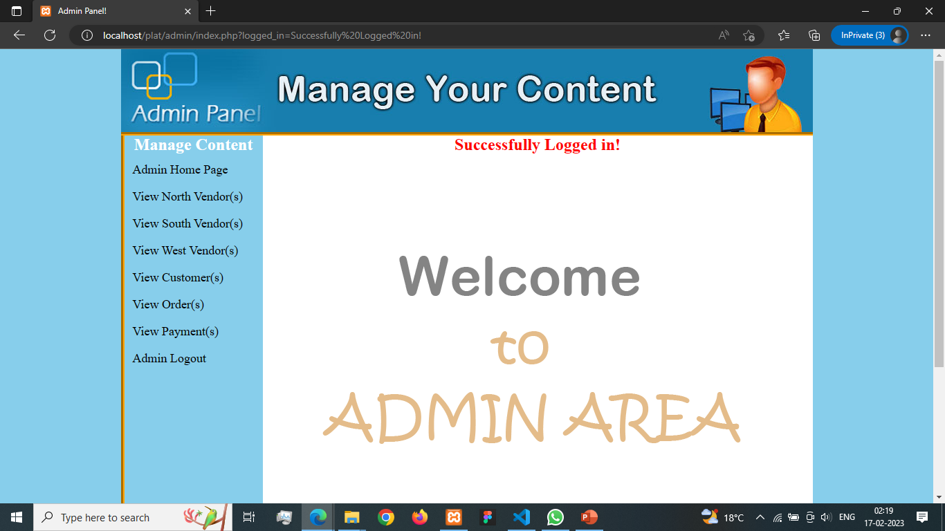

Slide 62
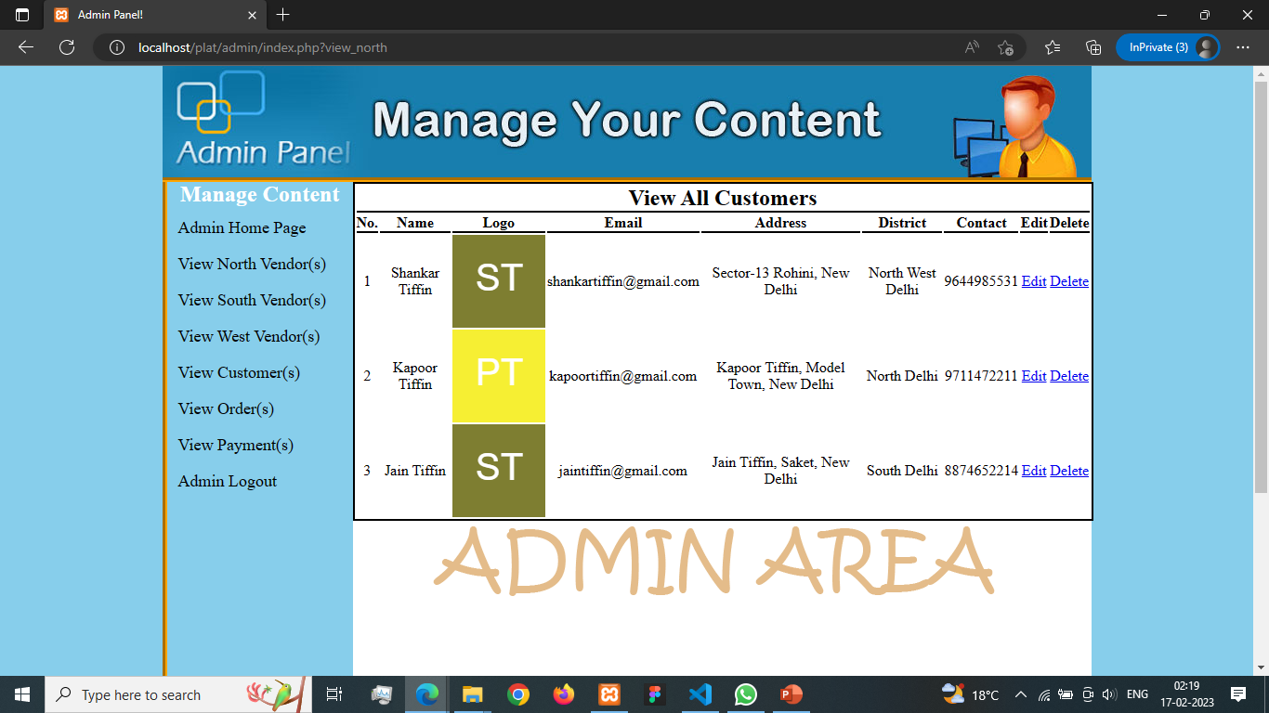

Slide 63
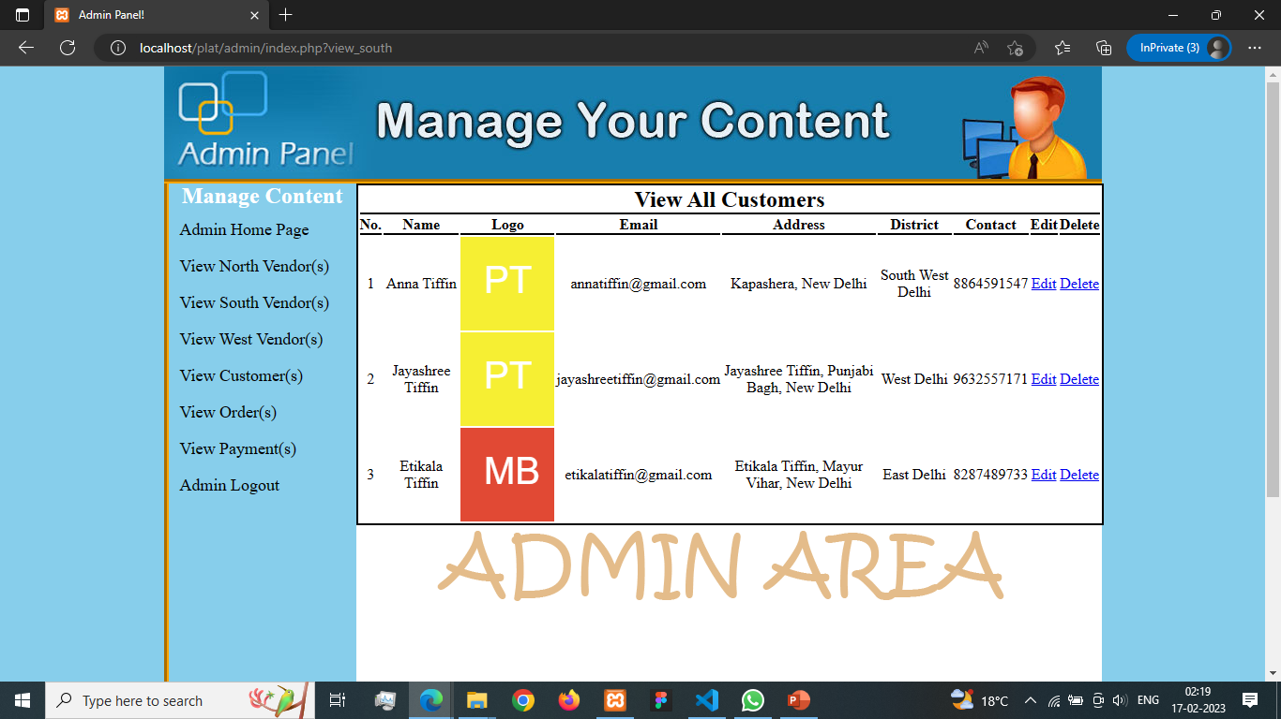

Slide 64
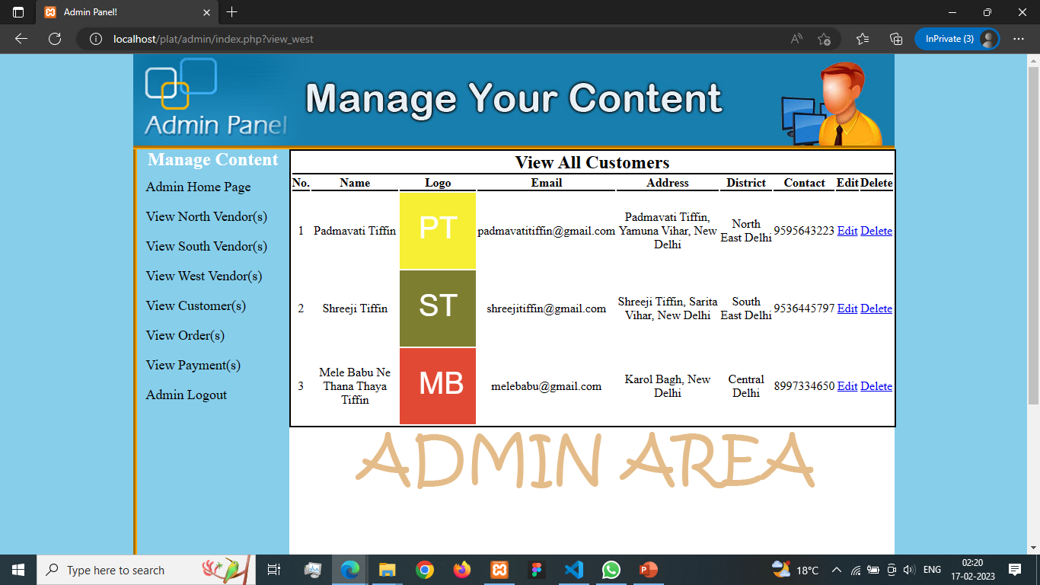

Slide 65
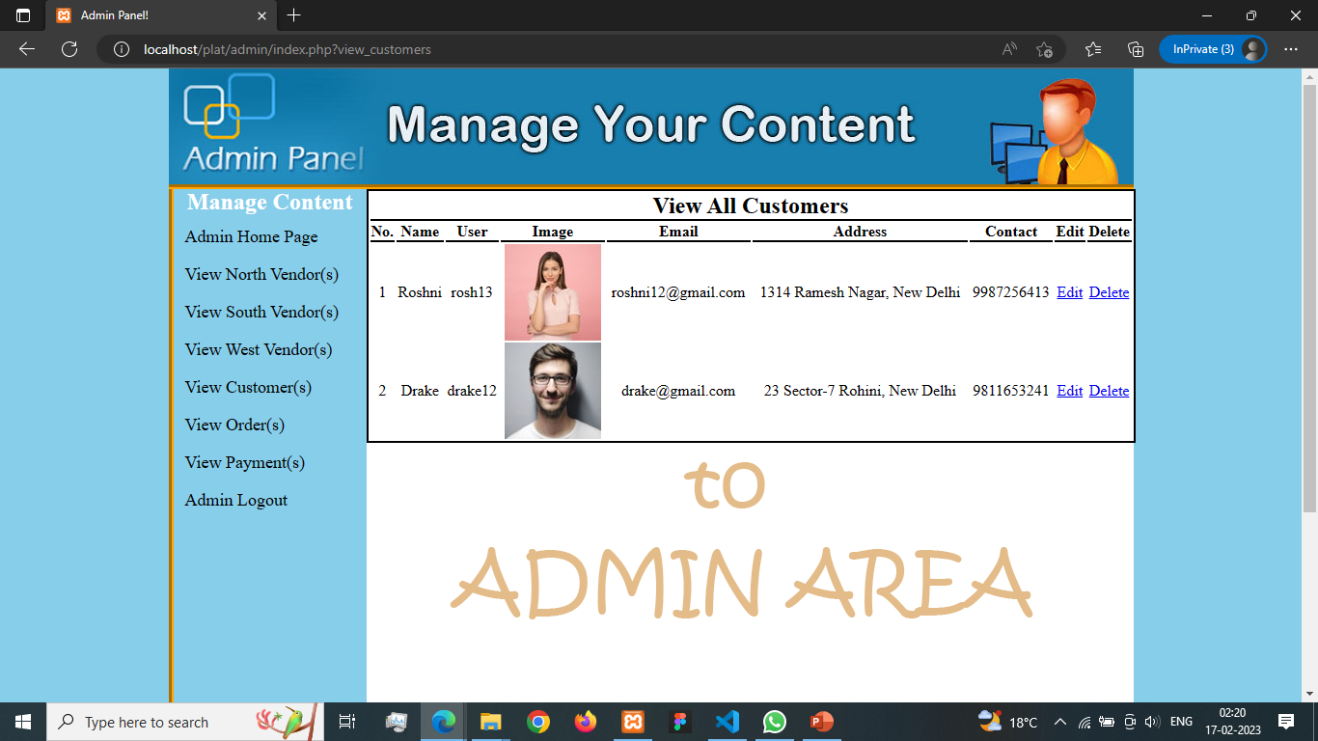

Slide 66
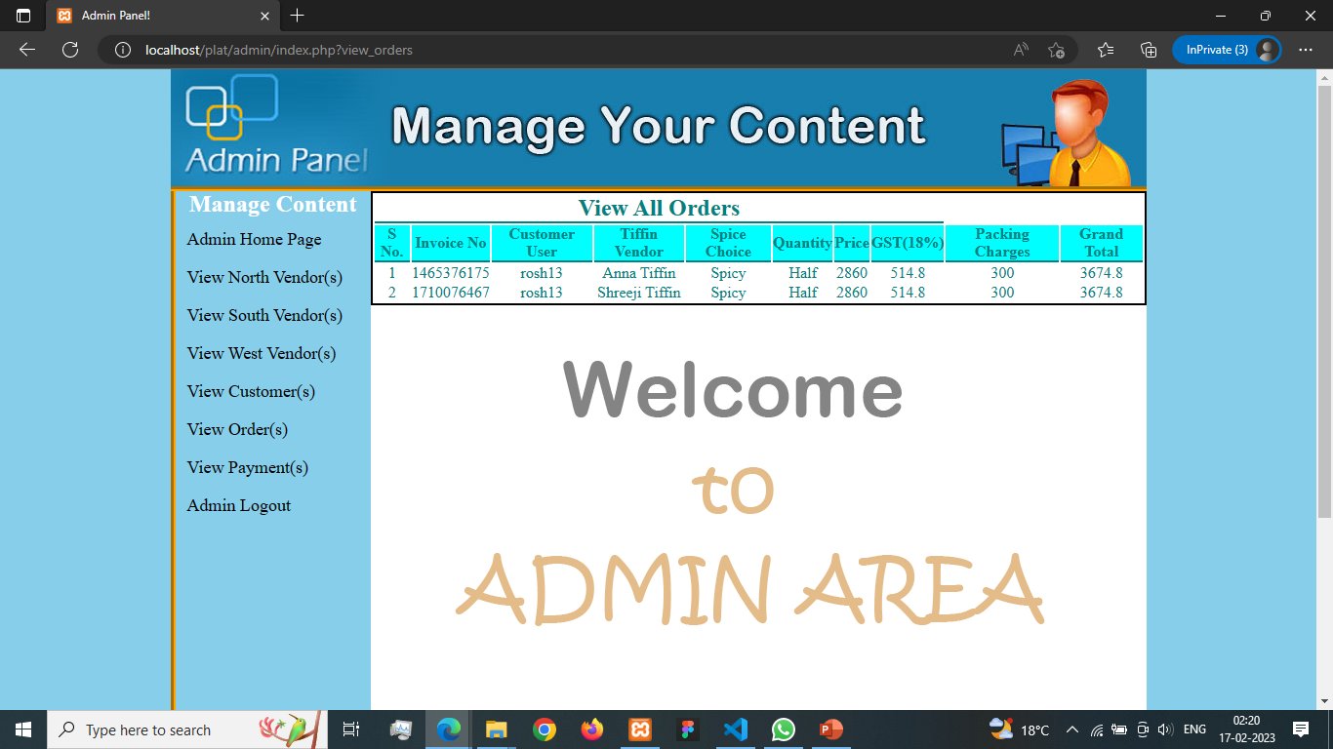

Slide 67
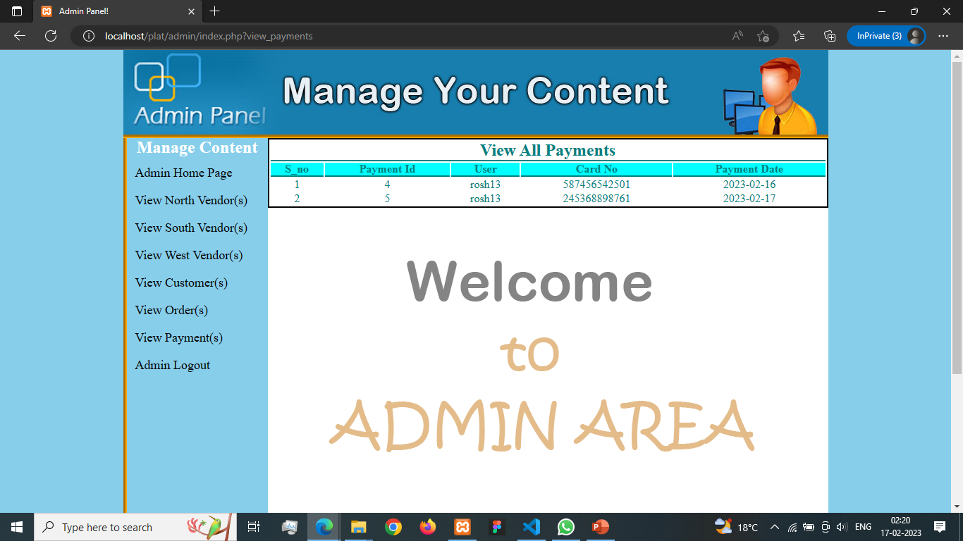

Slide 68
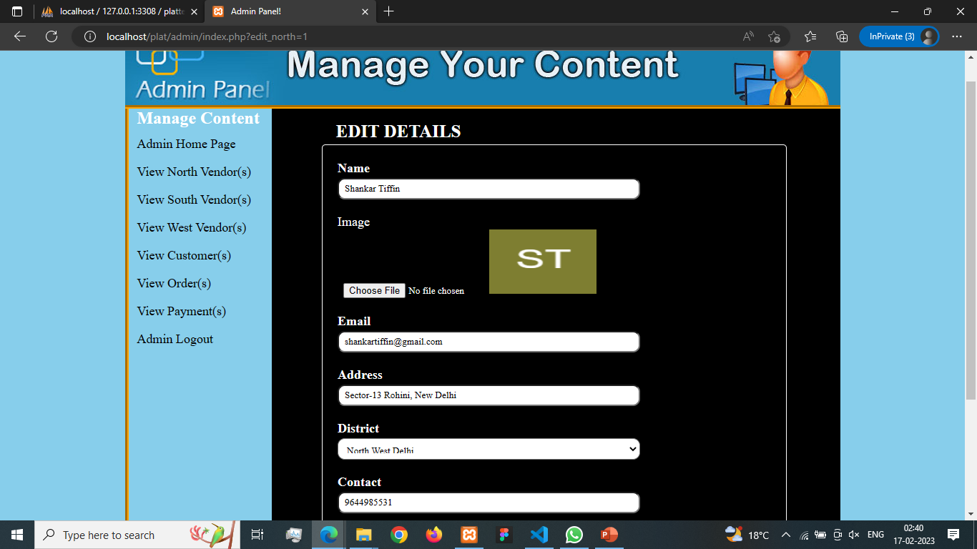

Slide 69
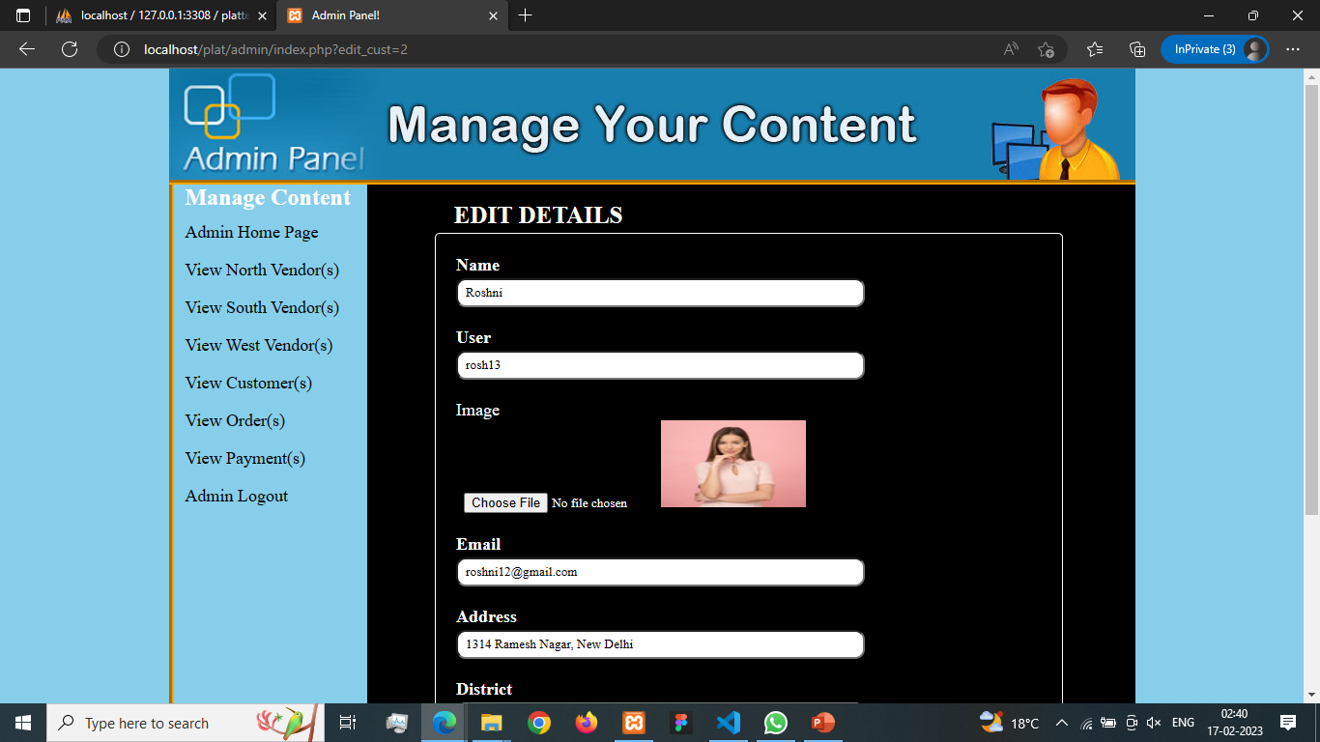

Slide 70
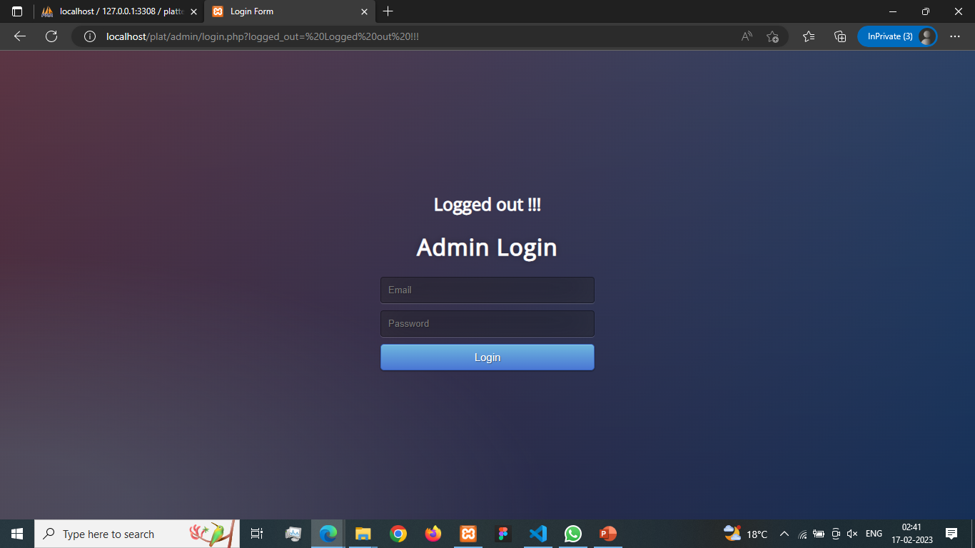

Slide 71
DATABASE- PLATTERLY
Admin
Bill Details
Customers
Meals
Payment Details
Rate
Regional Vendors
Vendors

Slide 72
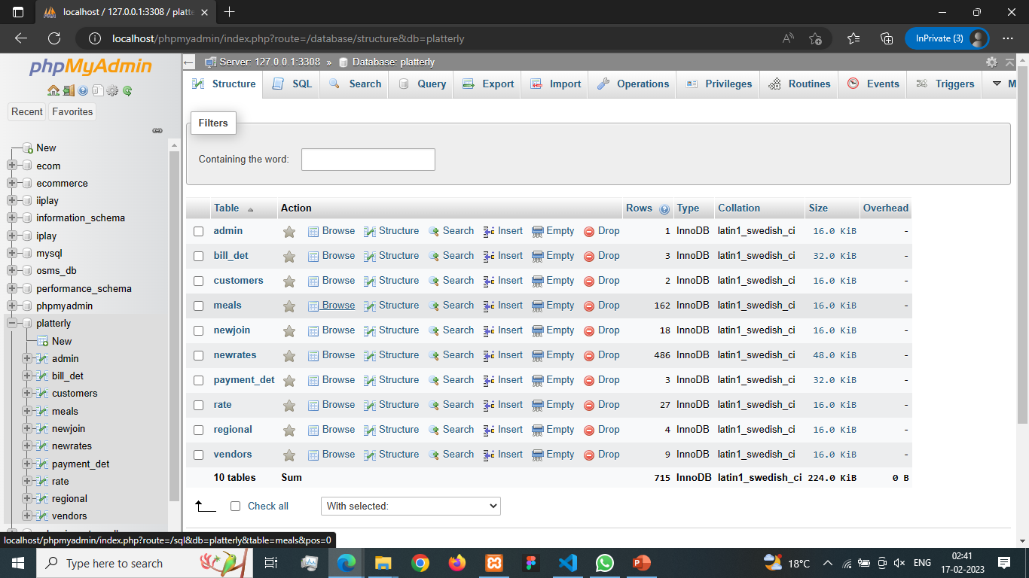

Slide 73
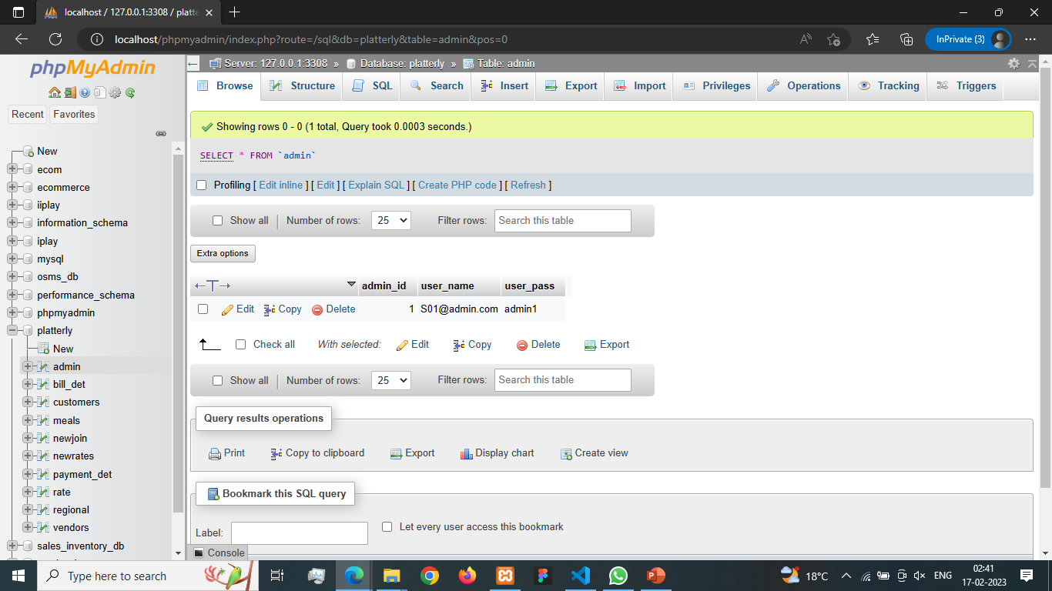

Slide 74
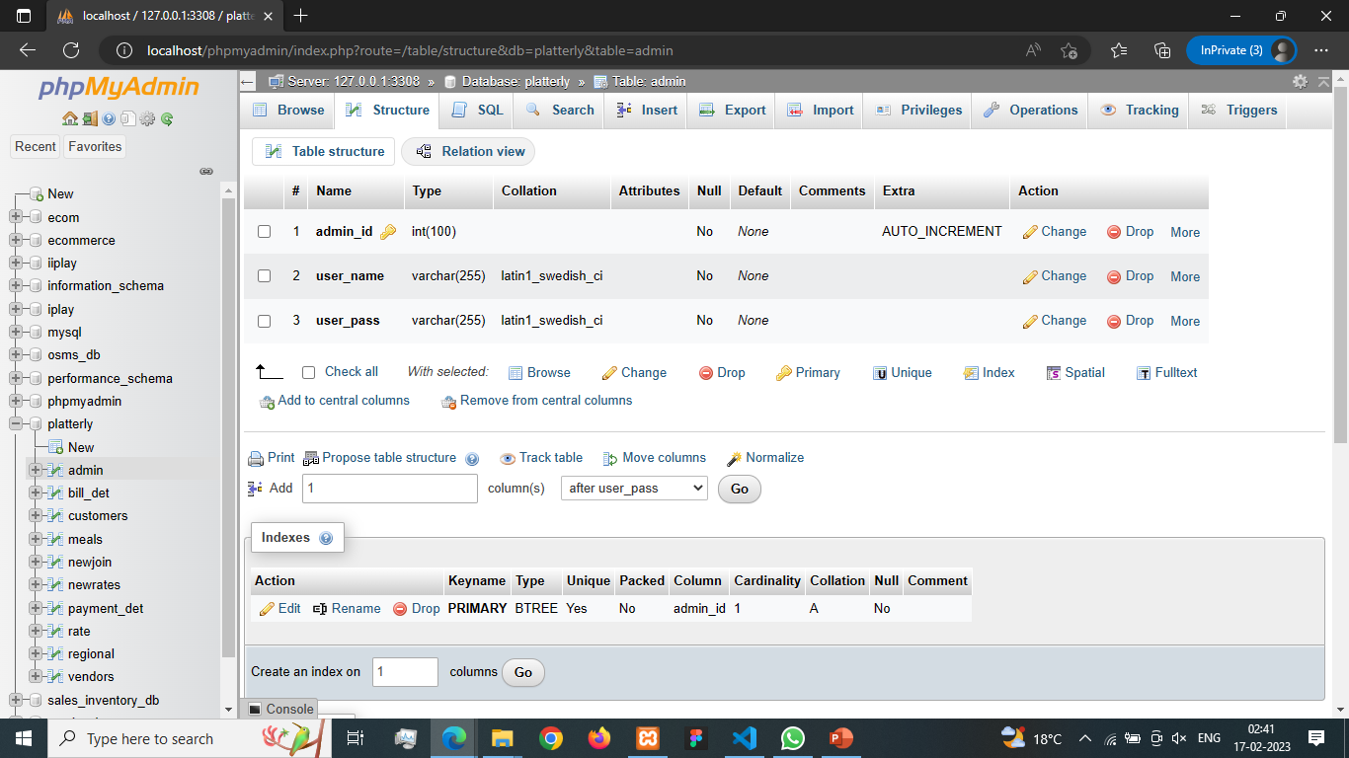

Slide 75
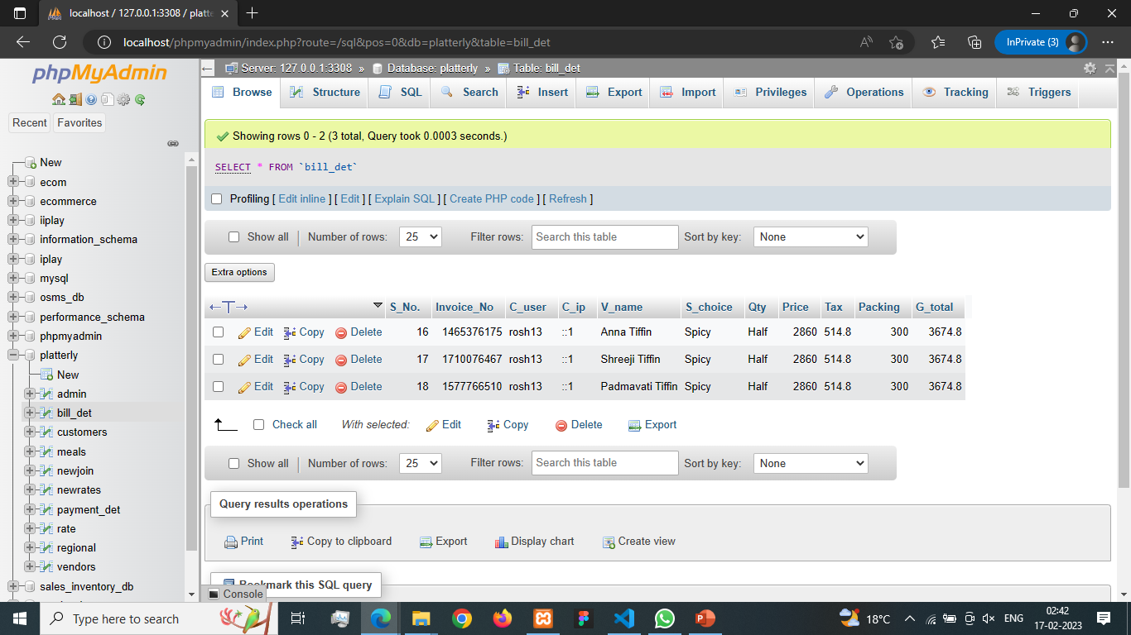

Slide 76
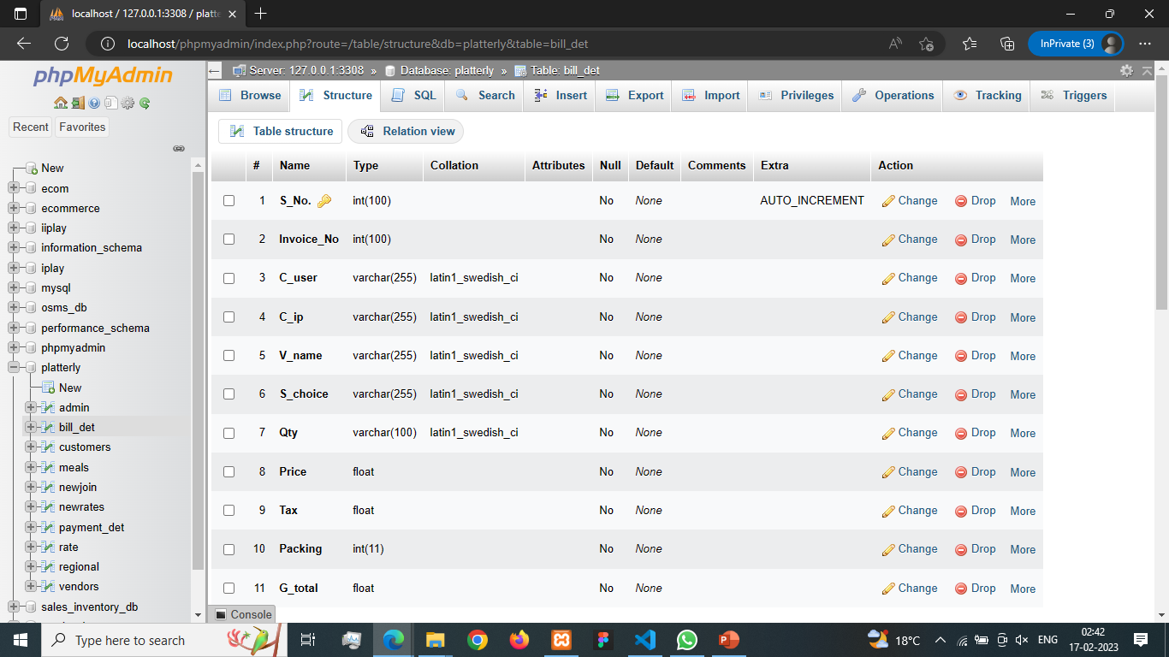

Slide 77
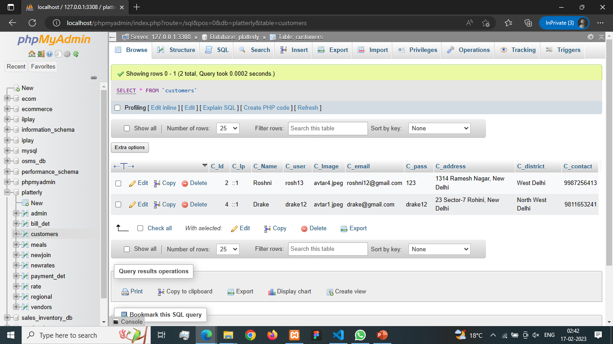

Slide 78


Slide 79


Slide 80


Slide 81


Slide 82


Slide 83


Slide 84


Slide 85


Slide 86


Slide 87


Slide 88


Slide 89


Slide 90


Slide 91


Slide 92


Slide 93


Slide 94


Slide 95


Slide 96


Slide 97
Future Modifications
Platterly can integrate with social media platforms to reach more customers and improve engagement.
The business can also consider adding new features like meal customization, nutritional information, and user reviews to enhance the customer experience.
Another area of potential growth is expanding the geographical coverage of the service. By partnering with local suppliers and delivery services.
The business can extend its reach to more areas and offer a wider variety of meal options.
Overall, the Platterly tiffin service website has significant potential to become a successful and innovative platform for healthy and convenient meal delivery.
With continued innovation and investment in technology, the website can continue to meet the changing needs and expectations of its customers and stay ahead of the competition.

Slide 98
THANK YOU!!

